Slide 1
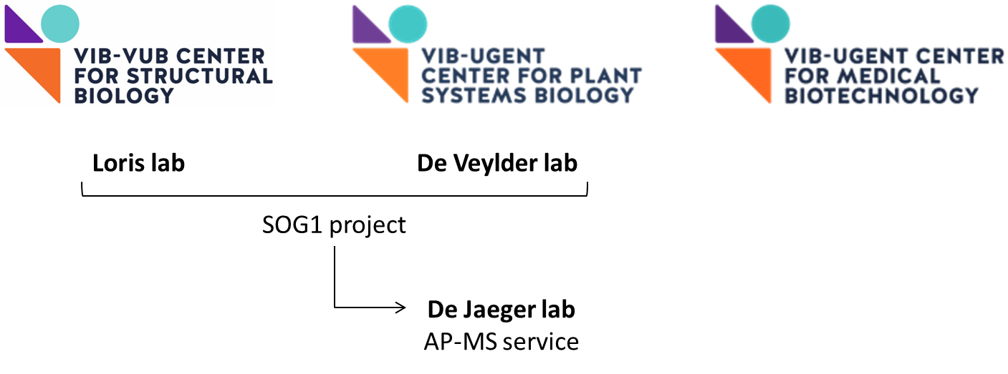


AtSOG TAD identification
library of tiles version 11
In scope of a research collaboration between R. Loris lab in VIB-VUB Center For Structural Biology (CSB) L. De Veylder lab in VIB-Ugent Center For Plant System Biology (PSB) M. Staller lab in University of California, Berkeley Margot Galle

Slide 2
Overview version 11: research questions
Basic tiles
Where is the AtSOG1 TAD located in its AA sequence?
Is this TAD conserved within the Arabidopsis NAC subfamily IX?
Is this TAD conserved amongst AtSOG1 orthologs?
II. AtSOG1 CTD phosphosite variations
Does the increase in negative net charge due to phosphorylation alter the identification of the AtSOG1 TAD in its AA sequence?
Does the increase in negative net charge due to phosphorylation alter the strength of the identified AtSOG1 TAD?
If so…
Do the experimentally confirmed AtSOG1 phosphosites suffice to induce this change or are additional phosphosites required (putative or not)?
Could the difference in TAD activity amongst variably phosphorylated tiles be linked to the SOG1 in planta phosphorylation priming behaviour?
III. AtSOG1 variations in charge and hydrophobicity in the putative TAD regions
Does the identified AtSOG1 TAD coincide with the results of the AdPred and/or PADDLE predictor?
Are negative charges originating from negatively charged residues and not those from phosphosites crucial to the identification and strength of the AtSOG1 TAD?
Is the presence of (bulky) hydrophobic residues crucial to the identification and strength of the AtSOG1 TAD?
Does the AtSOG1 TAD comply with the Acidic Exposure Model that was first formulated by Max Staller in his 2018 Cell Systems publication?
IV. AtSOG1 helical domain (HD) variations
Does the AtSOG1 TAD coincide with the C-terminal helical domain (CHD) predicted by AlphaFold?
If so…
Does disrupting helices in C-terminal region of AtSOG1 influence the TAD identification and/or activity ?
Do alterations in phosphosite background, charge and hydrophobicity have an individual and combined effect on the TAD activity?
Is the TAD activity dependent on specific sequence motifs or overall charge and hydrophobicity features?
V. Control tiles
Does the experimental set-up work for plant protein sequences as it does for yeast and mammalian protein sequences?

Slide 4
Overview version 11: research questions
Basic tiles
Where is the AtSOG1 TAD located in its AA sequence?
Is this TAD conserved within the Arabidopsis NAC subfamily IX?
Is this TAD conserved amongst AtSOG1 orthologs?
II. AtSOG1 CTD phosphosite variations
Does the increase in negative net charge due to phosphorylation alter the identification of the AtSOG1 TAD in its AA sequence?
Does the increase in negative net charge due to phosphorylation alter the strength of the identified AtSOG1 TAD?
If so…
Do the experimentally confirmed AtSOG1 phosphosites suffice to induce this change or are additional phosphosites required (putative or not)?
Could the difference in TAD activity amongst variably phosphorylated tiles be linked to the SOG1 in planta phosphorylation priming behaviour?
III. AtSOG1 variations in charge and hydrophobicity in the putative TAD regions
Does the identified AtSOG1 TAD coincide with the results of the AdPred and/or PADDLE predictor?
Are negative charges originating from negatively charged residues and not those from phosphosites crucial to the identification and strength of the AtSOG1 TAD?
Is the presence of (bulky) hydrophobic residues crucial to the identification and strength of the AtSOG1 TAD?
Does the AtSOG1 TAD comply with the Acidic Exposure Model that was first formulated by Max Staller in his 2018 Cell Systems publication?
IV. AtSOG1 helical domain (HD) variations
Does the AtSOG1 TAD coincide with none, one or both of the helical domains (HD) predicted by AlphaFold?
If so…
Does disrupting helices in C-terminal region of AtSOG1 influence the TAD identification and/or activity ?
Do alterations in phosphosite background, charge and hydrophobicity have an individual and combined effect on the TAD activity?
Is the TAD activity dependent on specific sequence motifs or overall charge and hydrophobicity features?
V. Control tiles
Does the experimental set-up work for plant protein sequences as it does for yeast and mammalian protein sequences?

Slide 5
I. Basic tiles
[A.] + [B.] + [C.]
Full length wild type protein sequence
AtSOG1 [A.]
AtSOG1-subfamily members [B.]
AtSOG1 orthologs [C.]
10 AA
Overlapping 40 AA tiles

Slide 6
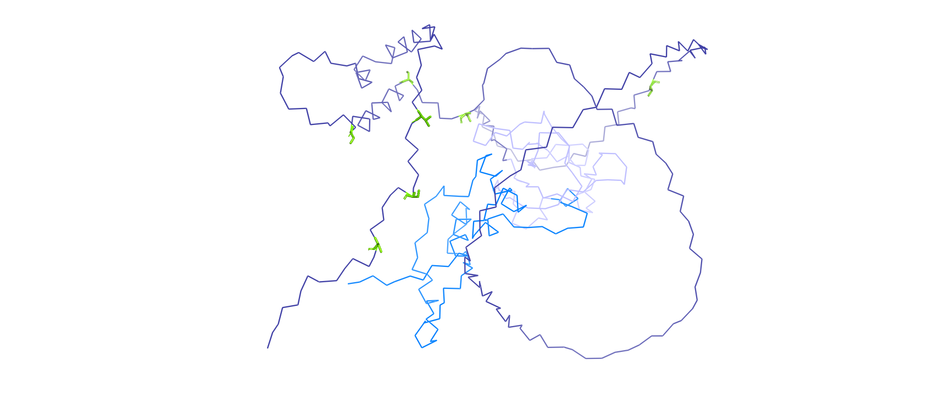
[A.]
AtSOG1
AtSOG1 tripartite composition: NTD and CTD are flexible. Conserved NAC is a (predominantly) folded DNA-binding domain
Green = Confirmed phosphosites
T244
S350
S356
S372
T423
S430
S436
NTD
NAC
CTD
57 aa pI 8,91
154 aa pI 9,28
238 aa pI 4,47
1
58
212
449
M1
D449

Slide 7
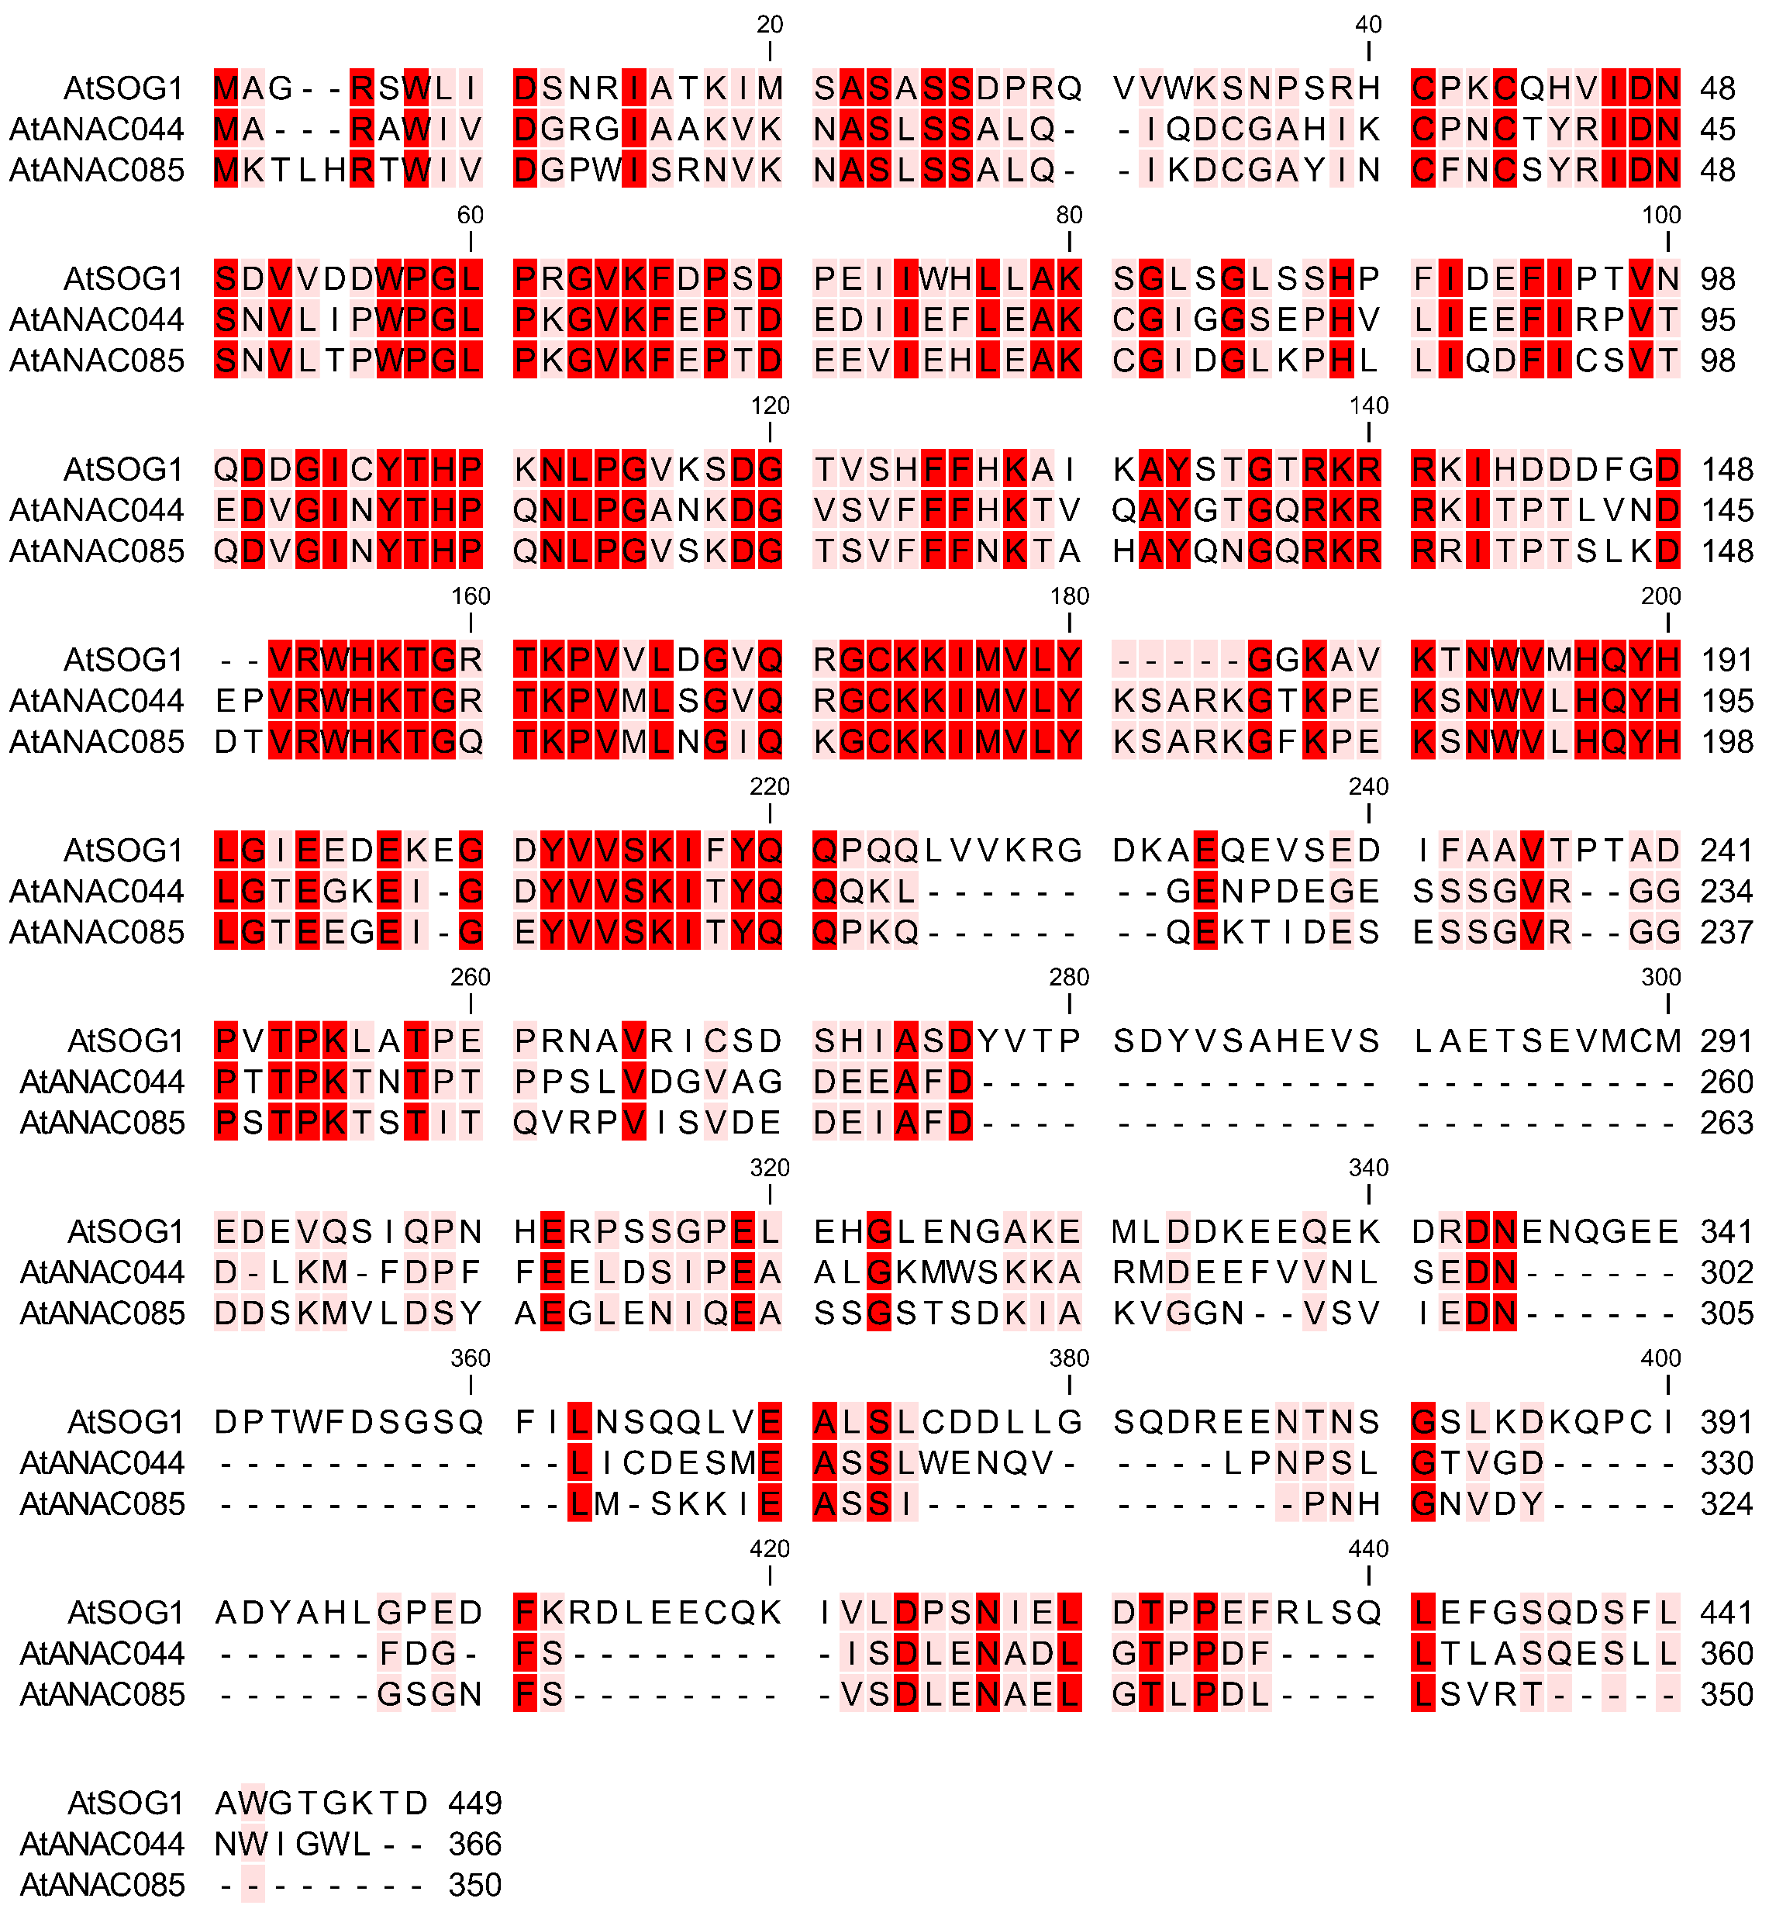
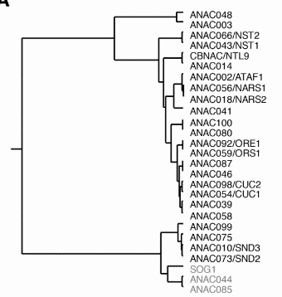
AtSOG1 subfamily
[B.]
Gradiation of red = the darker, the more conserved the position
Grey = Conserved NAC domain
Green = Confirmed AtSOG1 phosphosite motifs
Seq. id. (%) AtSOG1 – AtANAC044 = 36,62
Seq. id. (%) AtSOG1 – AtANAC085 = 33,41
Seq. id. (%) AtANAC044 – AtANAC085 = 61,83

Slide 8
[C.]
AtSOG1 orthologs (BlastP)
Embryophyta landplants
Bryophyta non-vascular
Tracheophyhta vascular
Spermatophyta seed plants
Marchantiophyta liverwort
Magnoliaphyta flowering plants
Monocot
Dicot
Marchantia polymorpha
umbrella liverwort
Zea mays
maize
Arabidopsis thaliana
thale cress
Physcomitrium patens
earthmoss
Oryza sativa
rice
Populus trichocarpa
poplar tree, black cottonwood tree

Slide 9
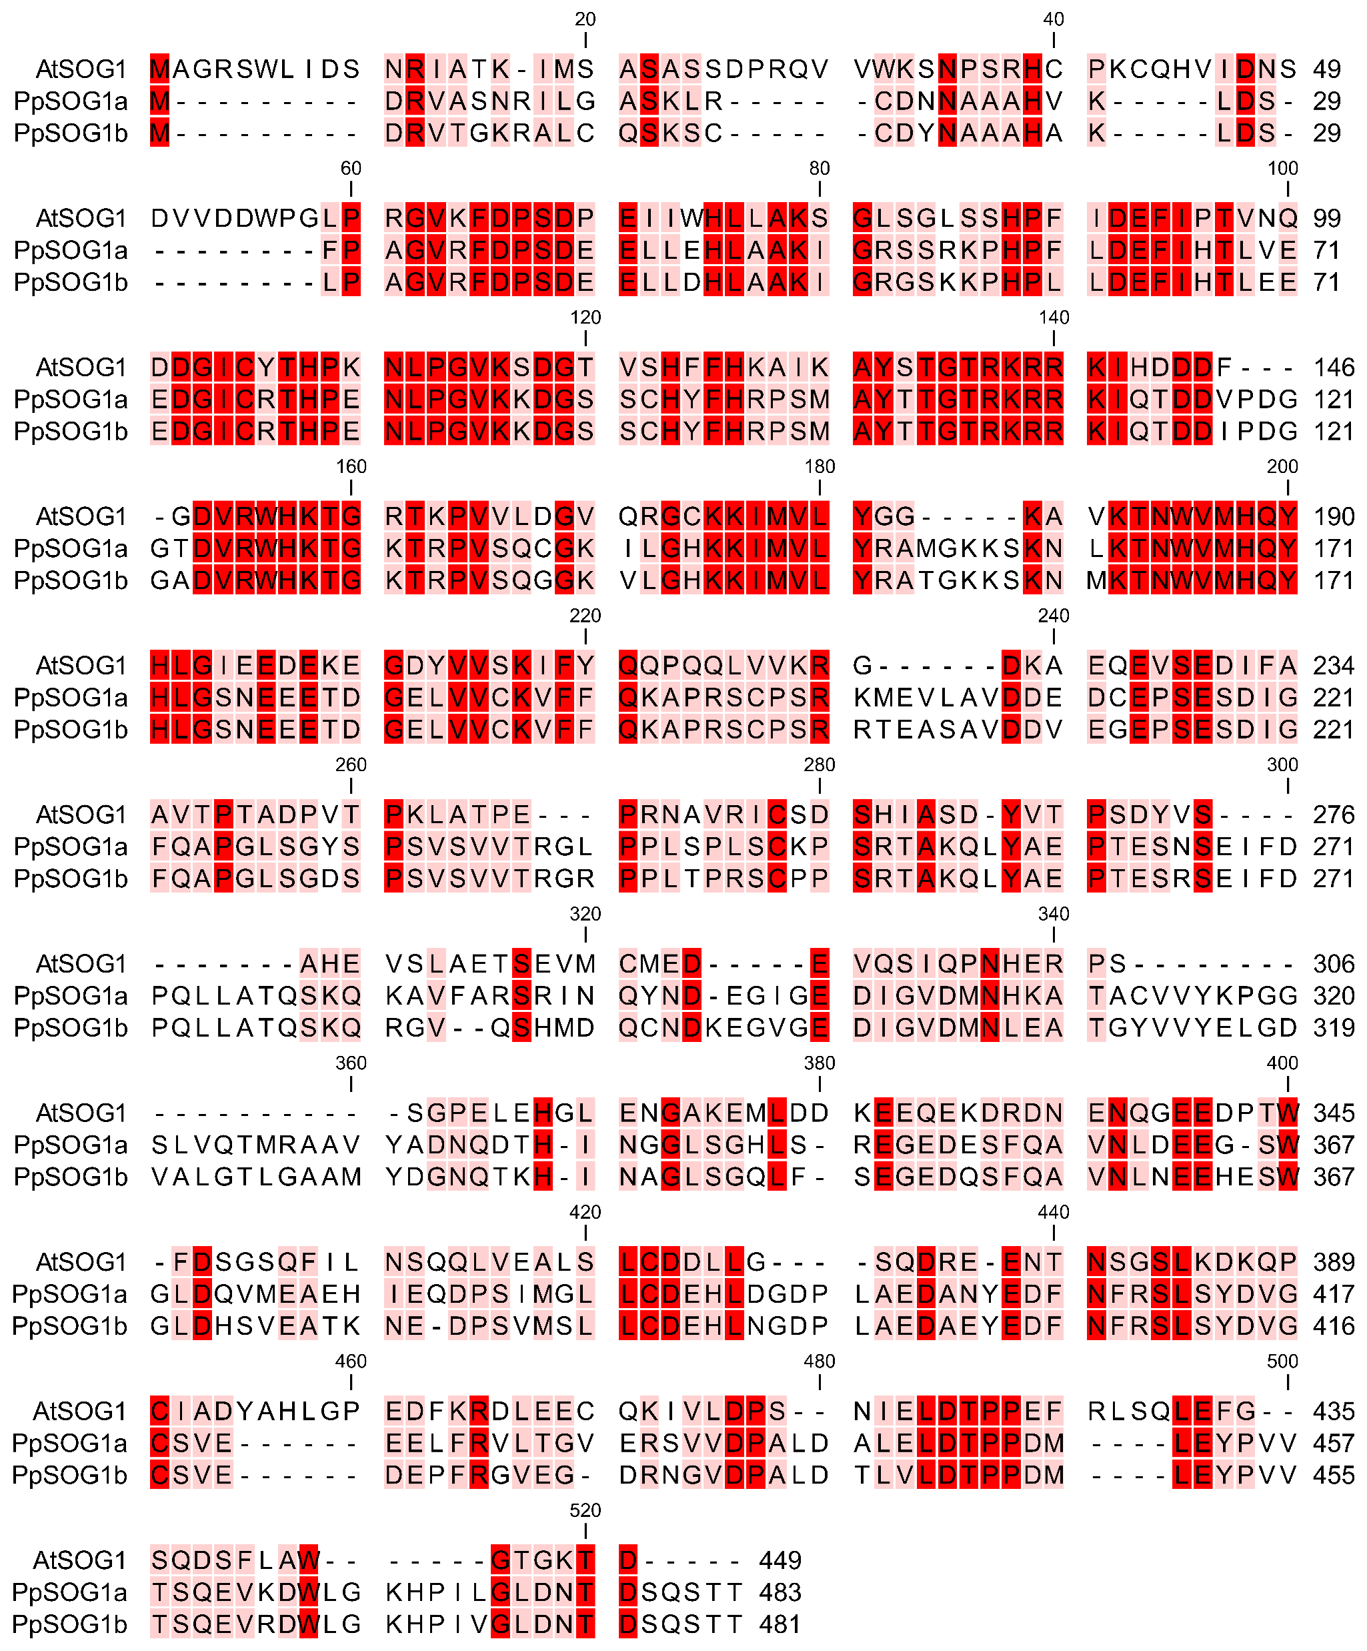
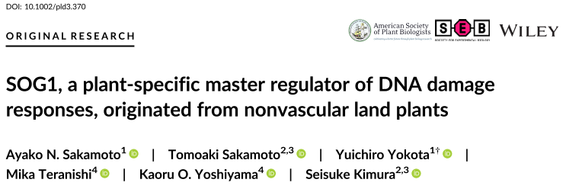
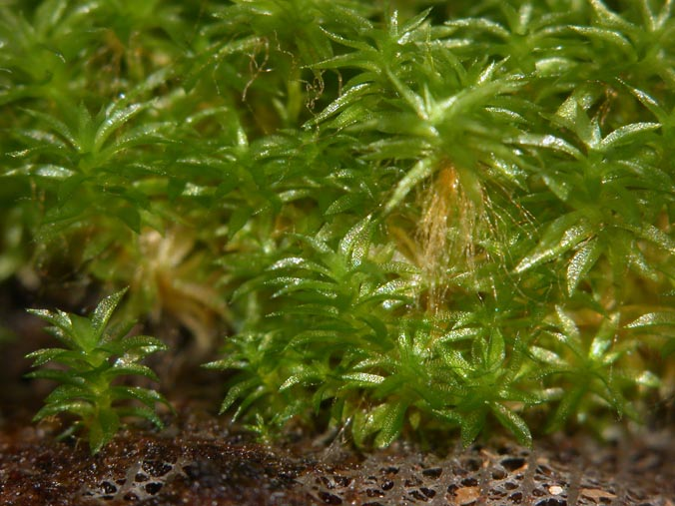
[C3.]
Psychomitrium patens
earthmoss
Be aware of the similarities with other AtNAC TFs!
Gradiation of red: the darker, the more conserved the position
Grey: Conserved NAC domain
Green: Confirmed AtSOG1 phosphosite motifs
Seq. id. (%) AtSOG1 – PpSOG1a = 30,67
Seq. id. (%) AtSOG1 – PpSOG1b = 30,42
Seq. id. (%) PpSOG1a – PpSOG1b = 80,21

Slide 10
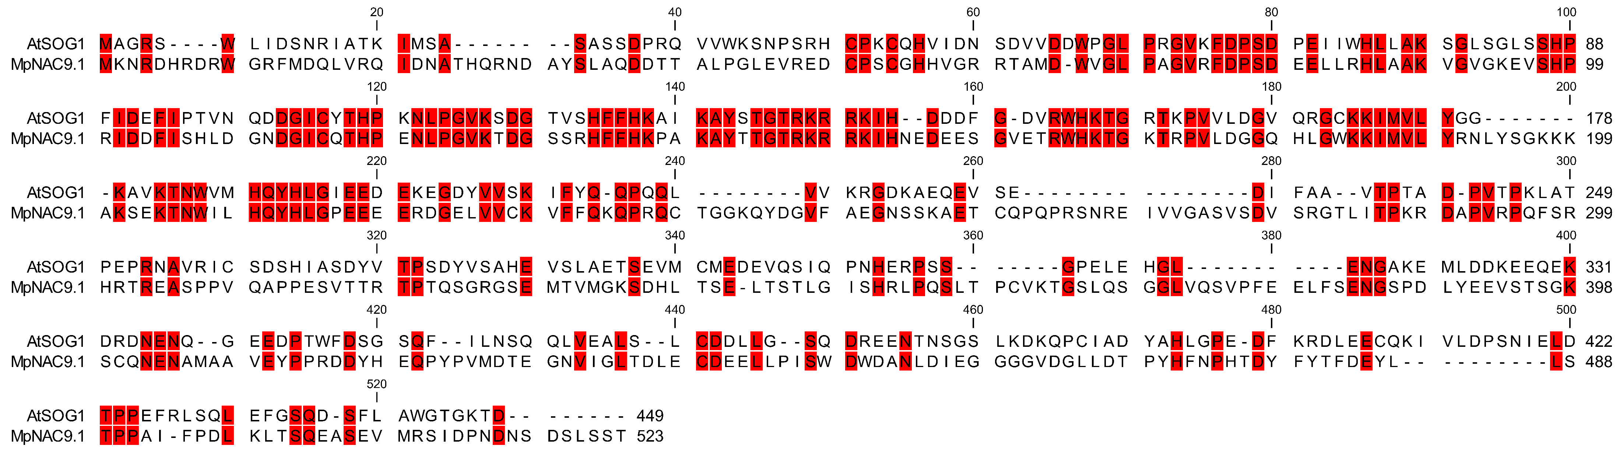
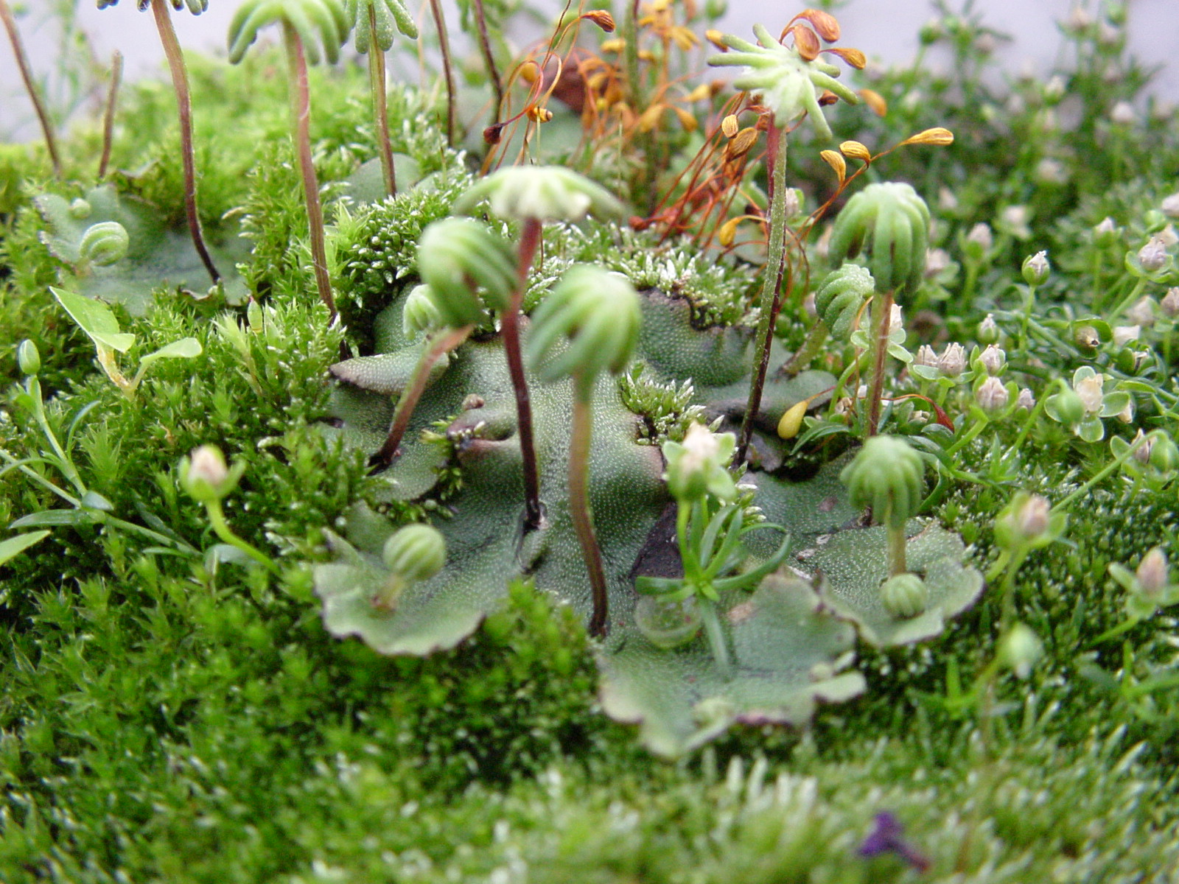
[C1.]
Marchantia polymorpha
umbrella liverwort
Be aware of the similarities with other AtNAC TFs!
Gradiation of red = the darker, the more conserved the position
Grey = Conserved NAC domain
Green = Confirmed AtSOG1 phosphosite motifs
Seq. id. (%) AtSOG1 – MpSOG1 = 31,16

Slide 11
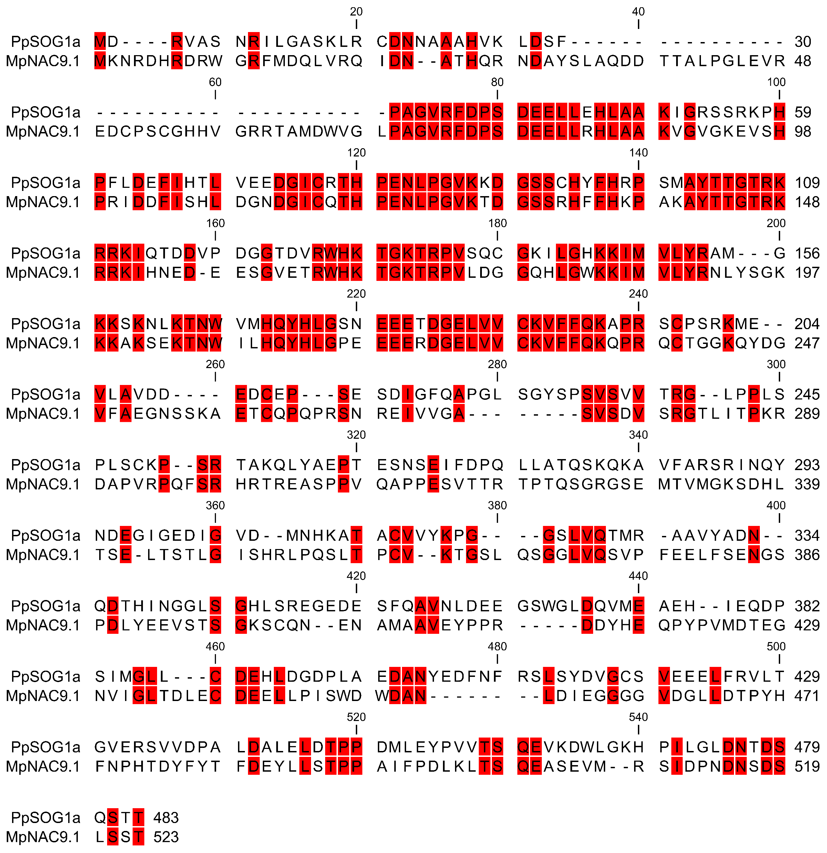
Gradiation of red: the darker, the more conserved the position
Grey: Conserved NAC domain
Green: Confirmed AtSOG1 phosphosite motifs
Seq. id. (%) PpSOG1a – MpNAC9.1 = 34,84

Slide 12
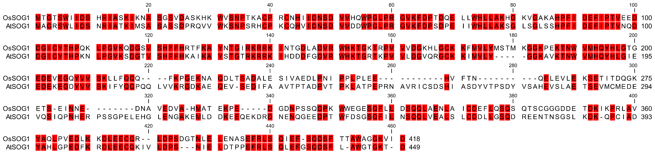
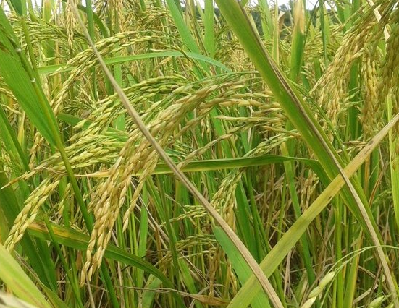
[C4.]
Oryza sativa
rice
Gradiation of red = the darker, the more conserved the position
Grey = Conserved NAC domain
Green = Confirmed AtSOG1 phosphosite motifs
Seq. id. (%) AtSOG1 – OsSOG1 = 50,11

Slide 13
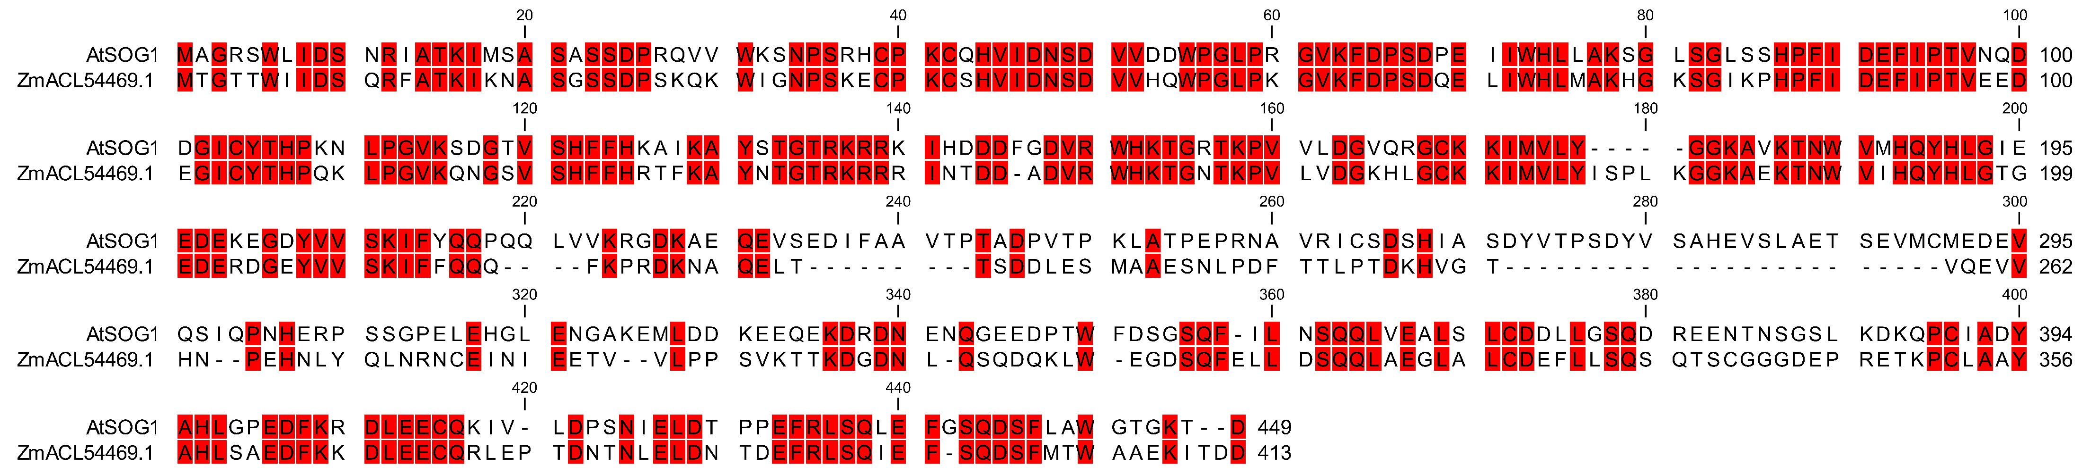
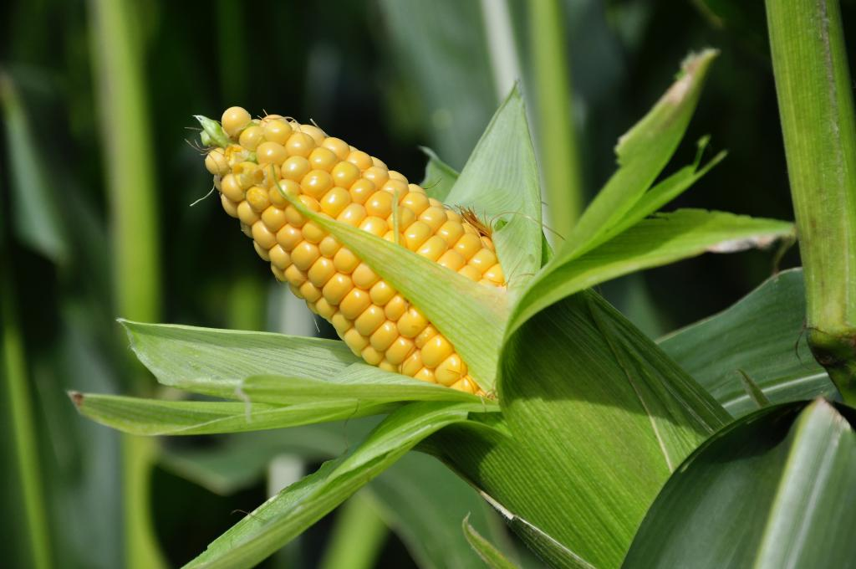
[C5.]
Zea mays
maize
Gradiation of red: the darker, the more conserved the position
Grey: Conserved NAC domain
Green: Confirmed AtSOG1 phosphosite motifs
Seq. id. (%) AtSOG1 – ZmSOG1 = 49,78

Slide 14
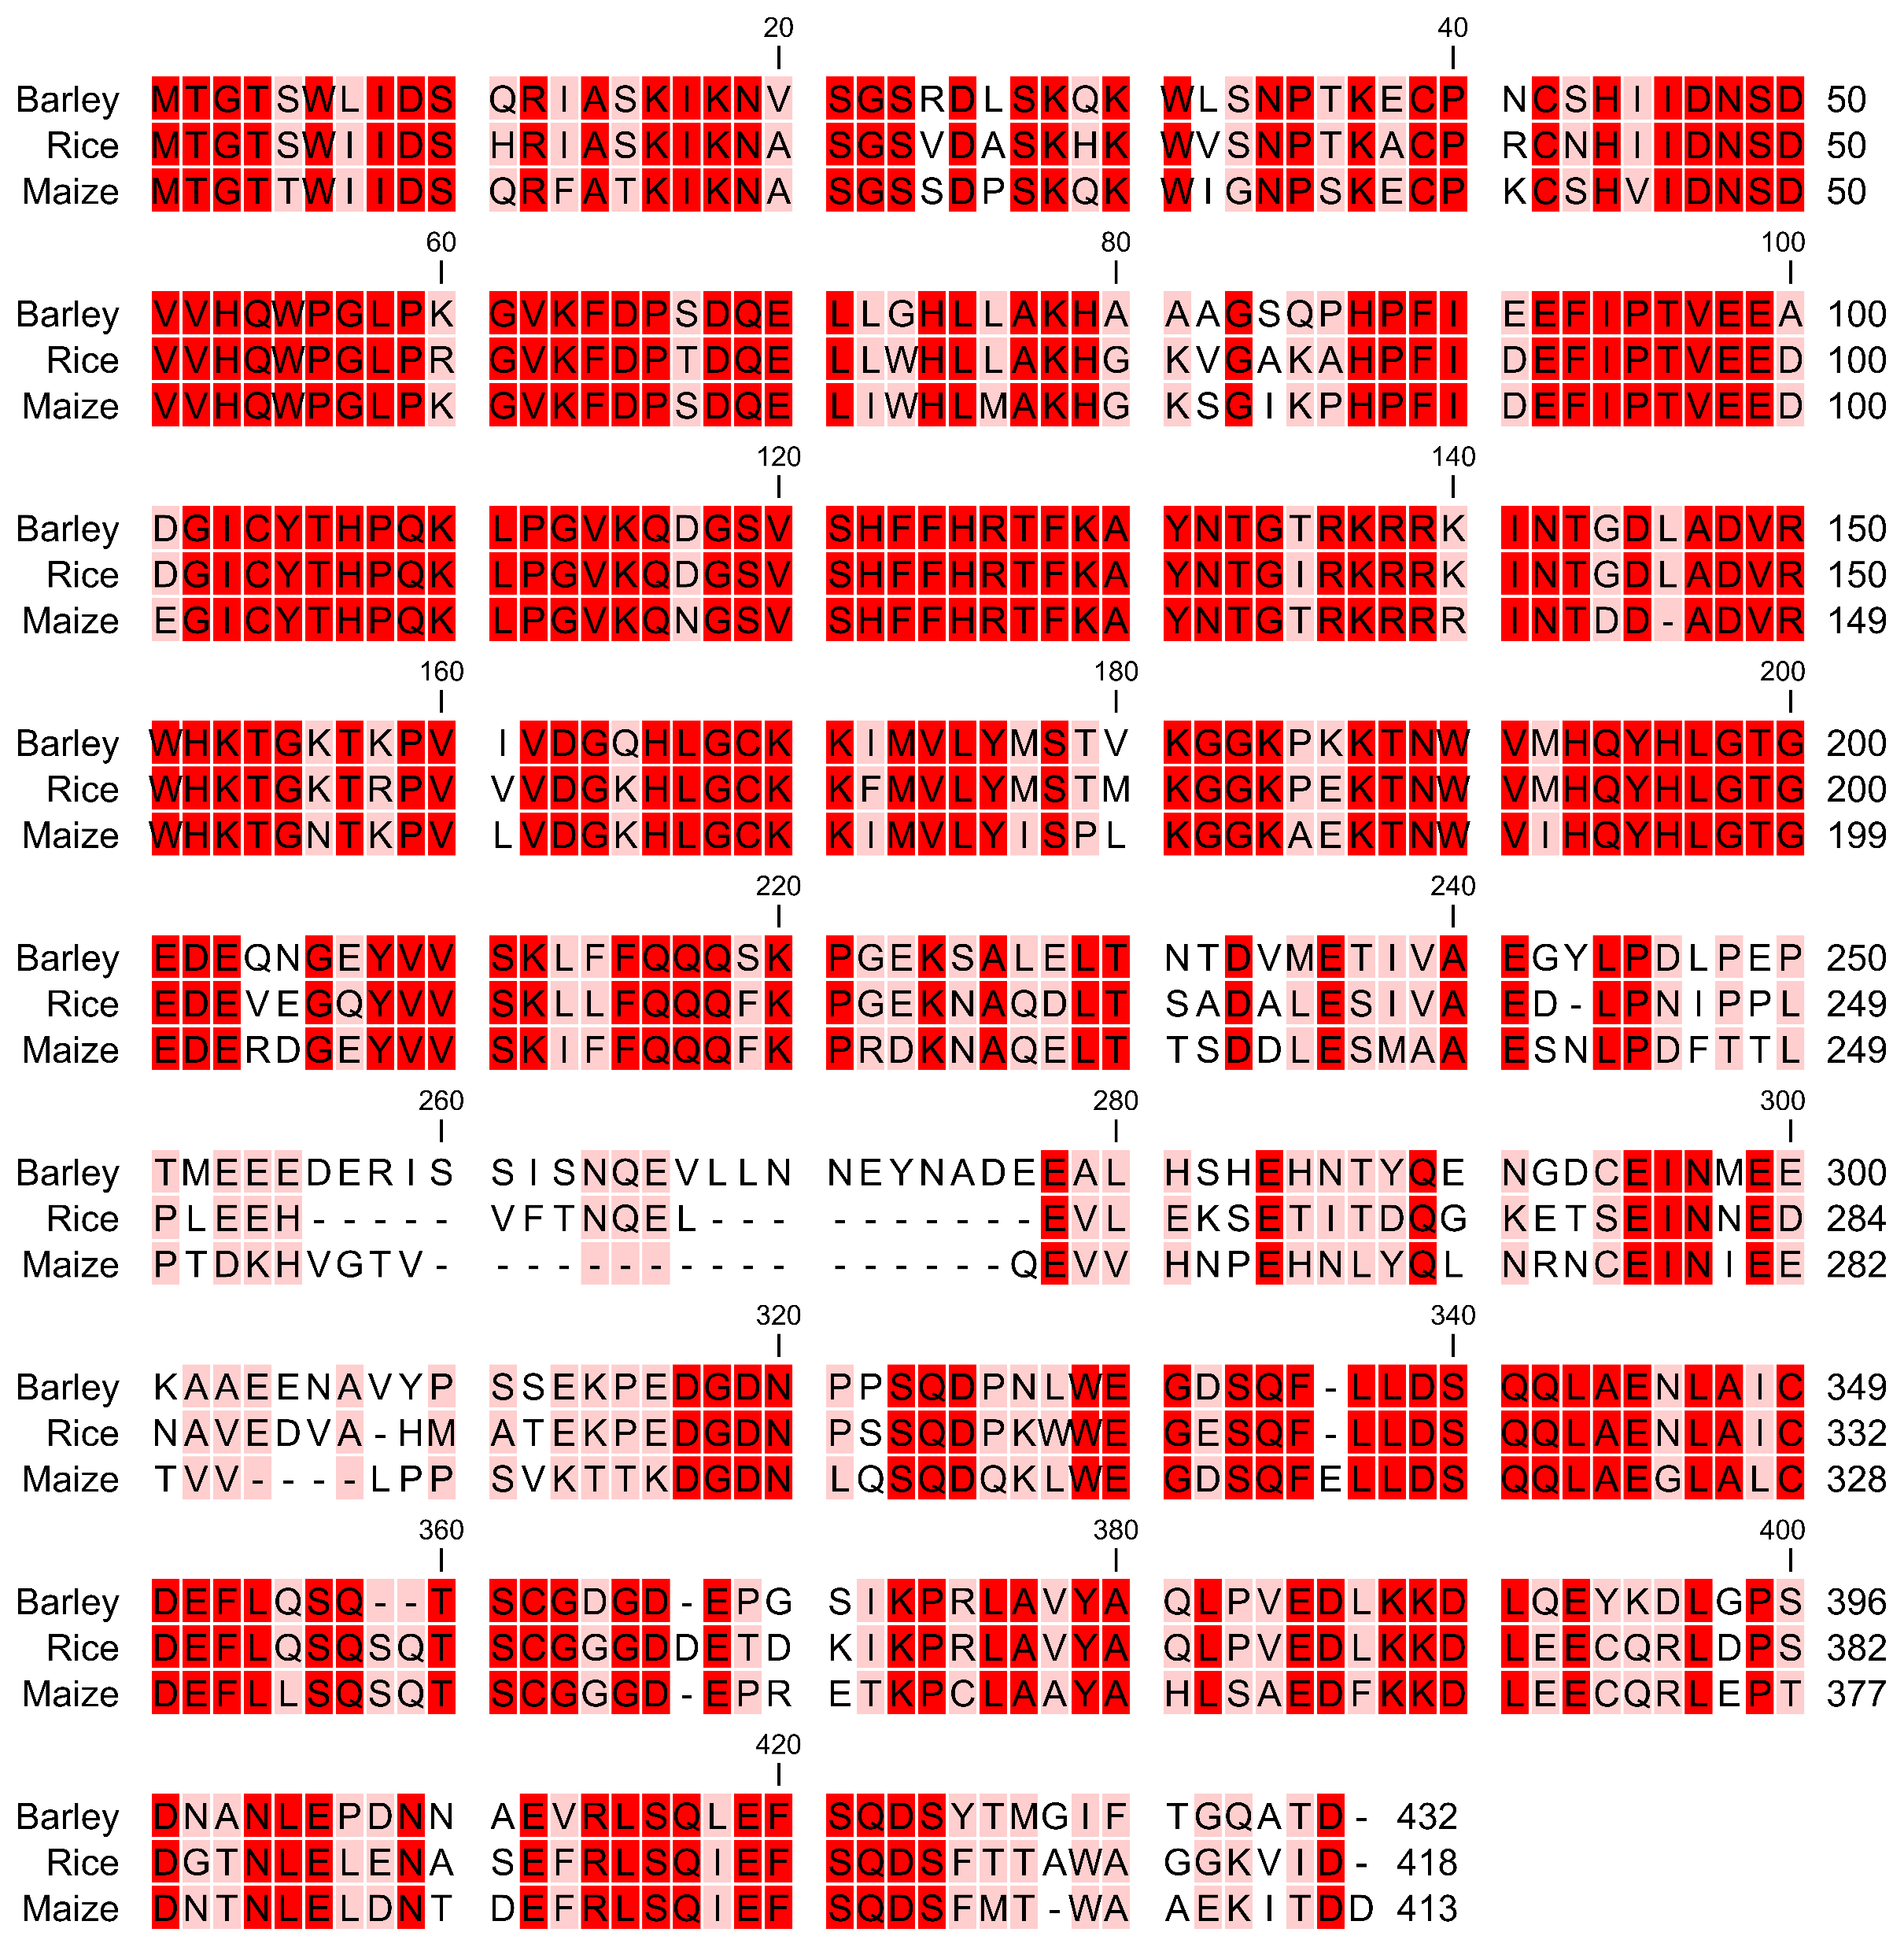
Gradiation of red: the darker, the more conserved the position
Grey: Conserved NAC domain
Green: Confirmed AtSOG1 phosphosite motifs
Seq. id. (%) barley – rice = 71,26
Seq. id. (%) barley – maize = 65,60
Seq. id. (%) rice – maize = 68,85
Prior versions encompassed a third monocot, Hordeum vulgare (barley). However, addition of this species did not add any value to the experiment because of to the high sequence identity between the 3 monocots. The barley sequence was replaced by a second moss species, Psychomitrium patens (earthmoss), instead.

Slide 15
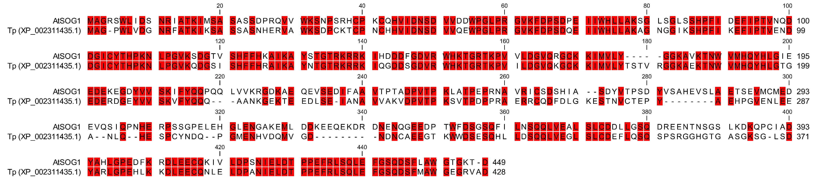
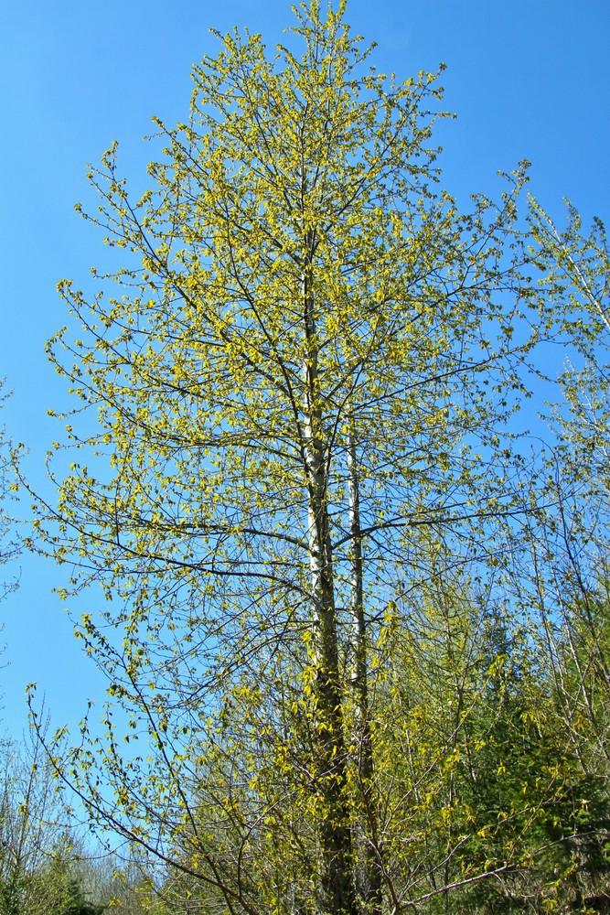
[C2.]
Populus trichocarpa
poplar tree, black cottonwood tree
Gradiation of red = the darker, the more conserved the position
Grey = Conserved NAC domain
Green = Confirmed AtSOG1 phosphosite motifs
Seq. id. (%) AtSOG1 – PtSOG1 = 59,52

Slide 16
Overview version 11: research questions
Basic tiles
Where is the AtSOG1 TAD located in its AA sequence?
Is this TAD conserved within the Arabidopsis NAC subfamily IX?
Is this TAD conserved amongst AtSOG1 orthologs?
II. AtSOG1 CTD phosphosite variations
Does the increase in negative net charge due to phosphorylation alter the identification of the AtSOG1 TAD in its AA sequence?
Does the increase in negative net charge due to phosphorylation alter the strength of the identified AtSOG1 TAD?
If so…
Do the experimentally confirmed AtSOG1 phosphosites suffice to induce this change or are additional phosphosites required (putative or not)?
Could the difference in TAD activity amongst variably phosphorylated tiles be linked to the SOG1 in planta phosphorylation priming behaviour?
III. AtSOG1 variations in charge and hydrophobicity in the putative TAD regions
Does the identified AtSOG1 TAD coincide with the results of the AdPred and/or PADDLE predictor?
Are negative charges originating from negatively charged residues and not those from phosphosites crucial to the identification and strength of the AtSOG1 TAD?
Is the presence of (bulky) hydrophobic residues crucial to the identification and strength of the AtSOG1 TAD?
Does the AtSOG1 TAD comply with the Acidic Exposure Model that was first formulated by Max Staller in his 2018 Cell Systems publication?
IV. AtSOG1 helical domain (HD) variations
Does the AtSOG1 TAD coincide with none, one or both of the helical domains (HD) predicted by AlphaFold?
If so…
Does disrupting helices in C-terminal region of AtSOG1 influence the TAD identification and/or activity ?
Do alterations in phosphosite background, charge and hydrophobicity have an individual and combined effect on the TAD activity?
Is the TAD activity dependent on specific sequence motifs or overall charge and hydrophobicity features?
V. Control tiles
Does the experimental set-up work for plant protein sequences as it does for yeast and mammalian protein sequences?

Slide 17
II. AtSOG1 CTD phosphosite (PS) variations
[D.]
“variation”: single or multiple substitutions at the respective AA position, without truncating the tile length.
Grey = AtSOG1 sequence (basic tiles 1-19) that is not included in category II tile variants.
Black = AtSOG1 sequence (basic tiles 20-2) included in in category II tile variants.
Green = Confirmed phosphosites
Red = Predicted phosphosites using PhosPhAt and the Eukaryotic Linear Motif (ELM) Resource
Underlined = Leftover Ser (S), Thr (T) and Tyr (Y) residues, non-putative phosphosites
NTD
NAC
CTD
MAGRSWLIDS NRIATKIMSA SASSDPRQVV WKSNPSRHCP KCQHVIDNSD VVDDWPG
LPRGVKFDPS DPEIIWHLLA KSGLSGLSSH PFIDEFIPTV NQDDGICYTH PKNLPGVKSD GTVSHFFHKA IKAYSTGTRK RRKIHDDDFG DVRWHKTGRT KPVVLDGVQR GCKKIMVLYG GKAVKTNWVM HQYHLGIEED EKEGDYVVSK IFYQ
QPQQLVVKRG DKAEQEVSED IFAAVTPTAD PVTPKLATPE PRNAVRICSD
SHIASDYVTP SDYVSAHEVS LAETSEVMCM EDEVQSIQPN HERPSSGPEL
EHGLENGAKE MLDDKEEQEK DRDNENQGEE DPTWFDSGSQ FILNSQQLVE
ALSLCDDLLG SQDREENTNS GSLKDKQPCI ADYAHLGPED FKRDLEECQK
IVLDPSNIEL DTPPEFRLSQ LEFGSQDSFL AWGTGKTD
res 1-57 [57 aa]; pI 8,91
NTD
NAC
CTD
res 58-211 [154 aa]; pI 9,28
AtSOG1 basic tile 20
NTD
NAC
CTD
res 212-449 [238 aa]; pI 4,47
Notes:
FL sequence:
Black: S005, S049, Y105, T119, Y176, Y190, S206, Y210, T237, T239, S297, S364, Y394, T445, T448
Red: S010, T015, S019, S021, S023, S024, S033, S036, S067, S079, S082, S085, S086, T096, T106, S116, S121, Y131, S132, T133, T135, T154, T157, T183, Y203, S229, T249, S260, S262, S266, Y268, T270, S272, Y274, S276, S281, T285, S286, S306, S307, T344, S348, T379, S381, S383, S417, S439
Green: T244, S350, S356, S372, T423, S430, S436

Slide 18
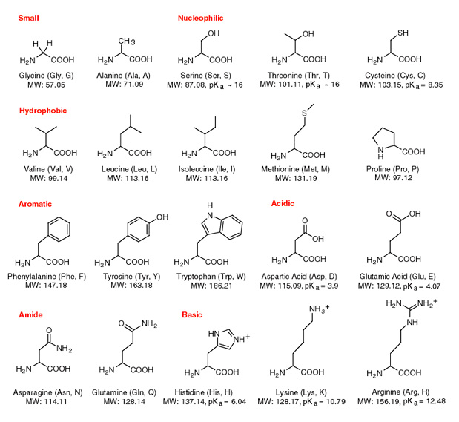
“phospho-X” where X represents either a phosphomutant or a phosphomimetic substitution.
[D2.]
X = mutant
X = mimetic
[D1.]
and
and
Serine (S)
Threonine (T)
Alanine (A)
Serine (S)
Threonine (T)
Aspartic acid (D)
Tyrosine (Y)
Phenylalanine (F)
Tyrosine (Y)
Glutamic acid (E)*
* Glu lacks the Tyr aromatic ring, but no better alternative found thus far.

Slide 19
Wild type background
S
T
S
Y
SQ
T
Y
T
Underlined = Non-putative phosphosites
Red = Predicted phosphosites (PhosPhAt + ELM Resource)
Green = Confirmed phosphosites
FULL phospho-X background
Single
X
X
XQ
X
X
X
X
X
Combinatorial
Full
[D1/2a.]
PREDICTED phospho-X background
Single
X
X
S
X
XQ
T
Y
X
Combinatorial
Full
[D1/2b.]
CONFIRMED phospho-X background
Single
[D1/2c.]
S
XQ
T
T
Y
S
Y
X
Combinatorial
[D1/2d.]
Full
[D1/2e.]

Slide 20
Overview version 11: research questions
Basic tiles
Where is the AtSOG1 TAD located in its AA sequence?
Is this TAD conserved within the Arabidopsis NAC subfamily IX?
Is this TAD conserved amongst AtSOG1 orthologs?
II. AtSOG1 CTD phosphosite variations
Does the increase in negative net charge due to phosphorylation alter the identification of the AtSOG1 TAD in its AA sequence?
Does the increase in negative net charge due to phosphorylation alter the strength of the identified AtSOG1 TAD?
If so…
Do the experimentally confirmed AtSOG1 phosphosites suffice to induce this change or are additional phosphosites required (putative or not)?
Could the difference in TAD activity amongst variably phosphorylated tiles be linked to the SOG1 in planta phosphorylation priming behaviour?
III. AtSOG1 variations in charge and hydrophobicity in the putative TAD regions
Does the identified AtSOG1 TAD coincide with the results of the AdPred and/or PADDLE predictor?
Are negative charges originating from negatively charged residues and not those from phosphosites crucial to the identification and strength of the AtSOG1 TAD?
Is the presence of (bulky) hydrophobic residues crucial to the identification and strength of the AtSOG1 TAD?
Does the AtSOG1 TAD comply with the Acidic Exposure Model that was first formulated by Max Staller in his 2018 Cell Systems publication?
IV. AtSOG1 helical domain (HD) variations
Does the AtSOG1 TAD coincide with none, one or both of the helical domains (HD) predicted by AlphaFold?
If so…
Does disrupting helices in C-terminal region of AtSOG1 influence the TAD identification and/or activity ?
Do alterations in phosphosite background, charge and hydrophobicity have an individual and combined effect on the TAD activity?
Is the TAD activity dependent on specific sequence motifs or overall charge and hydrophobicity features?
V. Control tiles
Does the experimental set-up work for plant protein sequences as it does for yeast and mammalian protein sequences?

Slide 21
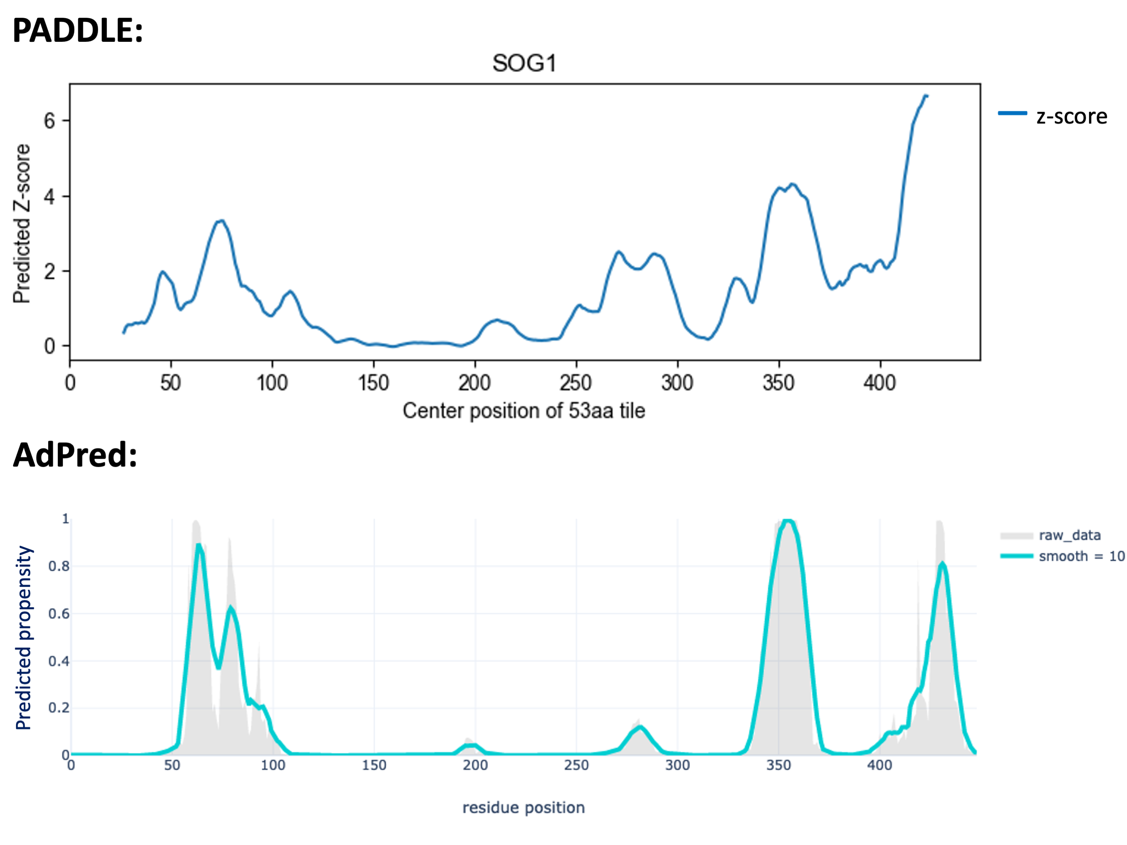
III. AtSOG1 variations in putative TAD regions
[E.] + [F.]
PADDLE
High-strength ADs: ≥ 5 consecutive positions with Z-score > 6.
Medium-strength Ads: ≥ 5 consecutive positions with Z-score > 4.
MPZ > 6
MPZ > 4
Score > 0.8
AdPred
AD predicted: ≥10-15 continuous residues with scores of ≥ 0.8.

Slide 22
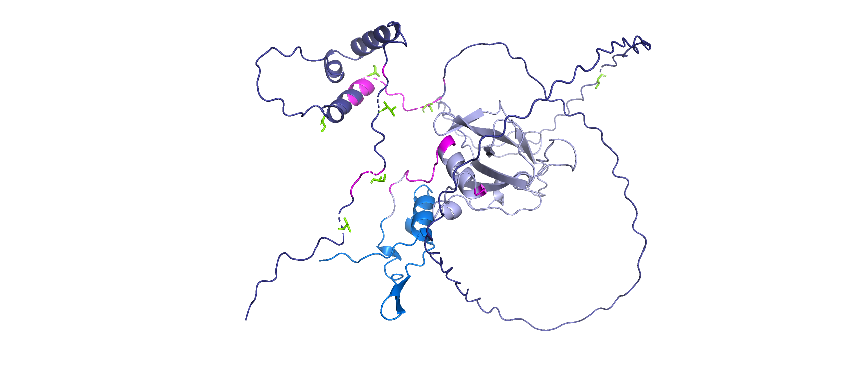
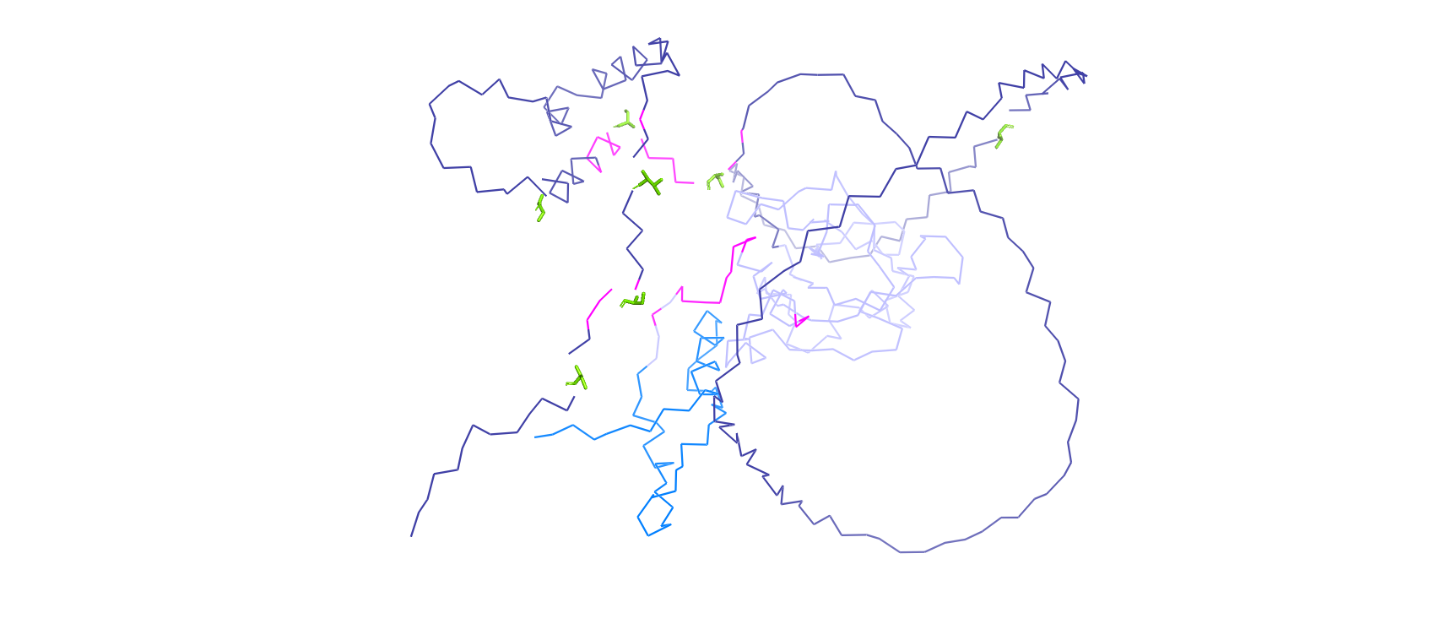
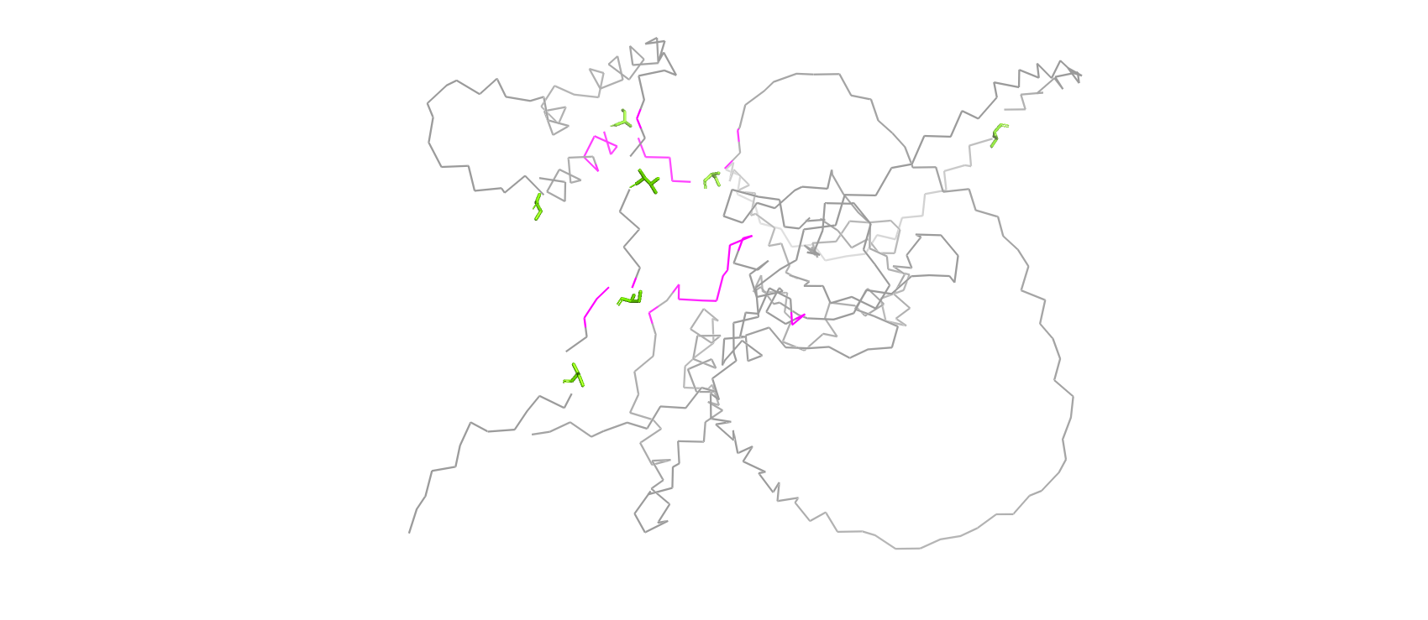
AdPred
M1
M1
M1
D449
D449
D449
NTD
NAC
CTD
MAGRSWLIDS NRIATKIMSA SASSDPRQVV WKSNPSRHCP KCQHVIDNSD VVDDWPG
res 1-57 [57 aa]; pI 8,91
NTD
NAC
CTD
LPRGVKFDPS DPEIIWHLLA KSGLSGLSSH PFIDEFIPTV NQDDGICYTH PKNLPGVKSD GTVSHFFHKA IKAYSTGTRK RRKIHDDDFG DVRWHKTGRT KPVVLDGVQR GCKKIMVLYG GKAVKTNWVM HQYHLGIEED EKEGDYVVSK IFYQ
res 58-211 [154 aa]; pI 9,28
QPQQLVVKRG DKAEQEVSED IFAAVTPTAD PVTPKLATPE PRNAVRICSD SHIASDYVTP SDYVSAHEVS LAETSEVMCM EDEVQSIQPN HERPSSGPEL EHGLENGAKE MLDDKEEQEK DRDNENQGEE DPTWFDSGSQ FILNSQQLVE ALSLCDDLLG SQDREENTNS GSLKDKQPCI ADYAHLGPED FKRDLEECQK IVLDPSNIEL DTPPEFRLSQ LEFGSQDSFL AWGTGKTD
NTD
NAC
CTD
res 212-449 [238 aa]; pI 4,47
Colors in figures match those in the AtSOG1 amino acid sequence.
Magenta = AdPred scores > 0.8 regardless of the number of consecutive positions
Green = Confirmed phosphosites

Slide 23
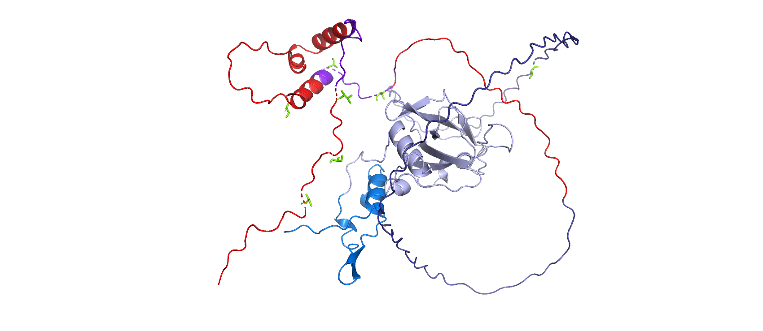
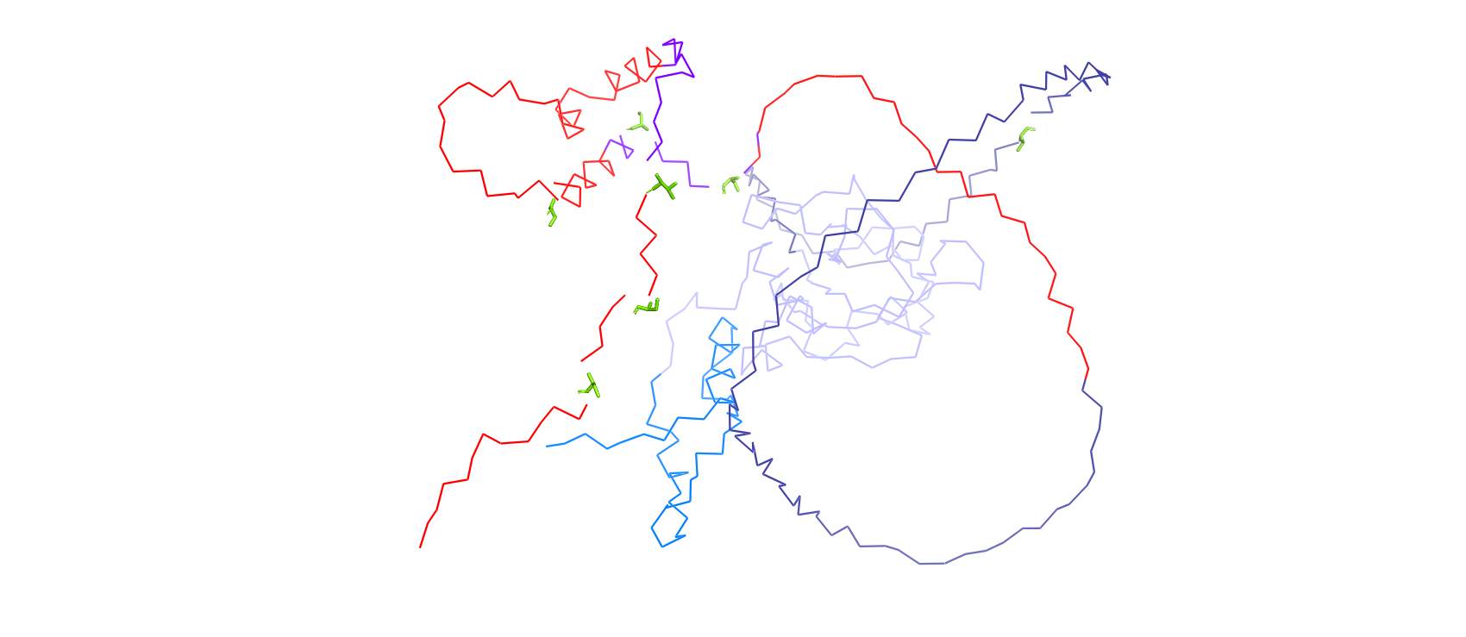
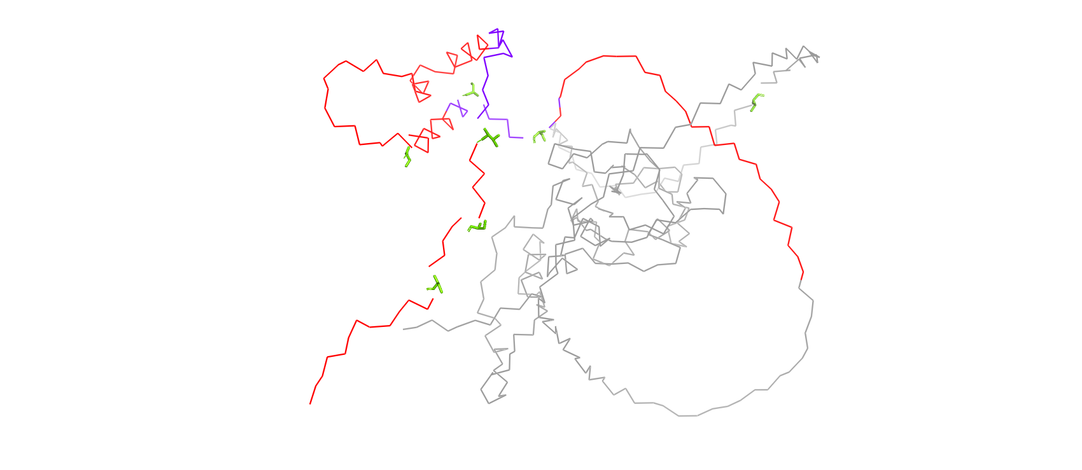
PADDLE
M1
M1
M1
D449
D449
D449
NTD
NAC
CTD
MAGRSWLIDS NRIATKIMSA SASSDPRQVV WKSNPSRHCP KCQHVIDNSD VVDDWPG
res 1-57 [57 aa]; pI 8,91
NTD
NAC
CTD
LPRGVKFDPS DPEIIWHLLA KSGLSGLSSH PFIDEFIPTV NQDDGICYTH PKNLPGVKSD GTVSHFFHKA IKAYSTGTRK RRKIHDDDFG DVRWHKTGRT KPVVLDGVQR GCKKIMVLYG GKAVKTNWVM HQYHLGIEED EKEGDYVVSK IFYQ
res 58-211 [154 aa]; pI 9,28
QPQQLVVKRG DKAEQEVSED IFAAVTPTAD PVTPKLATPE PRNAVRICSD SHIASDYVTP SDYVSAHEVS LAETSEVMCM EDEVQSIQPN HERPSSGPEL EHGLENGAKE MLDDKEEQEK DRDNENQGEE DPTWFDSGSQ FILNSQQLVE ALSLCDDLLG SQDREENTNS GSLKDKQPCI ADYAHLGPED FKRDLEECQK IVLDPSNIEL DTPPEFRLSQ LEFGSQDSFL AWGTGKTD
NTD
NAC
CTD
res 212-449 [238 aa]; pI 4,47
Colors in figures match those in the AtSOG1 amino acid sequence.
Purple = Center of the 53AA tiles predicted to encompass the TAD by PADDLE.
Red = AA sequence adjacent to the tiles’ centers in purple. Underlined = High-strength TAD predicted by PADDLE. Others predicted to be of medium strength.
Green = Confirmed phosphosites
Notes:
Red: not center of tile
Purple: center of tile
PADDLE medium (not underlined): M322 (MLDDK…) → K387 (…SGSLKDK); center 347-360
K385 (KDKQ…) → A442 (…SQDSFLA); center 410-415
PADDLE strong (underlined):
I391 (IADYA…) → D449; center 416-422

Slide 24
AdPred
M1
M1
M1
D449
D449
D449
PADDLE
M1
M1
M1
D449
D449
D449

Slide 25
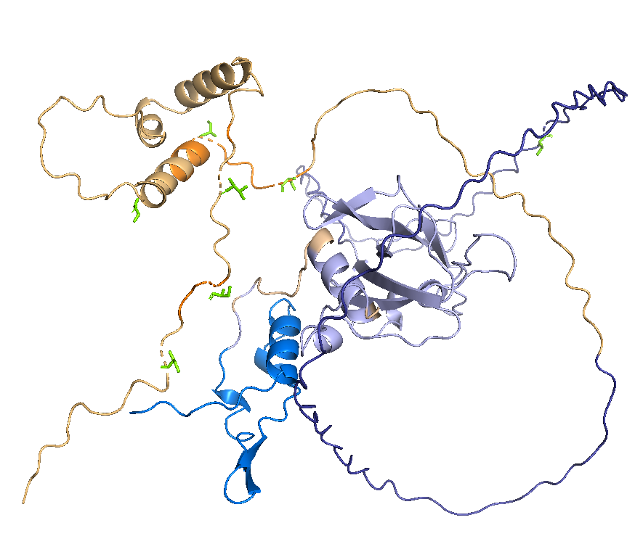
Colors in figures match those in the AtSOG1 amino acid sequence.
Yellow = Predicted TAD region by either PADDLE or AdPred
Orange = Predicted TAD region by both PADDLE and AdPred
Green: Confirmed phosphosites
NTD
NAC
CTD
res 1-57 [57 aa]; pI 8,91
MAGRSWLIDS NRIATKIMSA SASSDPRQVV WKSNPSRHCP KCQHVIDNSD VVDDWPG
NTD
NAC
CTD
res 58-211 [154 aa]; pI 9,28
LPRGVKFDPS DPEIIWHLLA KSGLSGLSSH PFIDEFIPTV NQDDGICYTH PKNLPGVKSD GTVSHFFHKA IKAYSTGTRK RRKIHDDDFG DVRWHKTGRT KPVVLDGVQR GCKKIMVLYG GKAVKTNWVM HQYHLGIEED EKEGDYVVSK IFYQ
NTD
NAC
CTD
res 212-449 [238 aa]; pI 4,47
M1
QPQQLVVKRG DKAEQEVSED IFAAVTPTAD PVTPKLATPE PRNAVRICSD SHIASDYVTP SDYVSAHEVS LAETSEVMCM EDEVQSIQPN HERPSSGPEL EHGLENGAKE MLDDKEEQEK DRDNENQGEE DPTWFDSGSQ FILNSQQLVE ALSLCDDLLG SQDREENTNS GSLKDKQPCI ADYAHLGPED FKRDLEECQK IVLDPSNIEL DTPPEFRLSQ LEFGSQDSFL AWGTGKTD
D449

Slide 26
3 features combined into 2 categories of tiles : ① phosphosite background – ② hydrophobicity [E.] – ③ net charge [F.]
Basic tile 31 (301-340) NHERPSSGPE LEHGLENGAK EMLDDKEEQE KDRDNENQGE
Basic tile 32 (311-350) LEHGLENGAK EMLDDKEEQE KDRDNENQGE EDPTWFDSGS
Basic tile 33 (321-360) EMLDDKEEQE KDRDNENQGE EDPTWFDSGS QFILNSQQLV
Basic tile 34 (331-370) KDRDNENQGE EDPTWFDSGS QFILNSQQLV EALSLCDDLL
Basic tile 35 (341-380) EDPTWFDSGS QFILNSQQLV EALSLCDDLL GSQDREENTN
Basic tile 36 (351-390) QFILNSQQLV EALSLCDDLL GSQDREENTN SGSLKDKQPC
Basic tile 37 (361-400) EALSLCDDLL GSQDREENTN SGSLKDKQPC IADYAHLGPE
Basic tile 38 (371-410) GSQDREENTN SGSLKDKQPC IADYAHLGPE DFKRDLEECQ
Basic tile 39 (381-420) SGSLKDKQPC IADYAHLGPE DFKRDLEECQ KIVLDPSNIE
Basic tile 40 (391-430) IADYAHLGPE DFKRDLEECQ KIVLDPSNIE LDTPPEFRLS
Basic tile 41 (401-440) DFKRDLEECQ KIVLDPSNIE LDTPPEFRLS QLEFGSQDSF
Basic tile 42 (410-449) QKIVLDPSNI ELDTPPEFRL SQLEFGSQDS FLAWGTGKTD
Underlined = Predicted TAD region by either PADDLE, AdPred or both
Red = Predicted phosphosites (PhosPhAt + ELM Resource)
Green = (Bulky) hydrophobic residue: F, W, Y and L
Blue = Negative charged residue: D and E
Green = Confirmed phosphosites
Notes:
WT and mutant differently enough to include both?

Slide 27
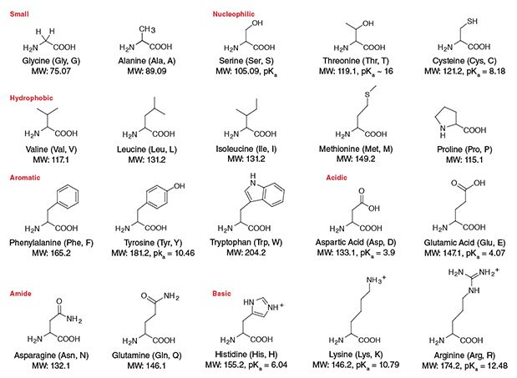
Wild type background
S
Y
SQ
S
T
T
Y
T
T
[E1.]
X = mutant
[E2.]
X = mimetic
Single
Combinatorial
Full
CONFIRMED phospho-X background
CONFIRMED phospho-X background
CONFIRMED phospho-X background
S
Y
XQ
S
Y
XQ
T
T
S
Y
XQ
S
T
T
Y
S
T
Y
S
T
T
T
X
T
Y
X
X
D
D
E
X
D
X
X
X
X
0%
50%
100%
and
and
Asparagine (N)
Glutamine (Q)
Aspartic acid (D)
Glutamic acid (E)
Alanine (A)
Lysine (K)

Slide 28
Wild type background
S
Y
SQ
S
T
T
Y
T
T
[F1.]
X = mutant
[F2.]
X = mimetic
Single
Combinatorial
Full
CONFIRMED phospho-X background
CONFIRMED phospho-X background
CONFIRMED phospho-X background
S
Y
XQ
S
Y
XQ
T
T
S
Y
XQ
S
T
T
Y
S
T
Y
S
T
T
T
X
T
Y
X
X
X
W
F
L
X
X
X
X
W
0%
50%
100%
Be aware of
the choice of hydrophobicity scale and its implications for the tile design!
Phenylalanine (F)
Tryptophan (W)
Tyrosine (Y)
Leucine (L)
Alanine (A)

Slide 29
Overview version 11: research questions
Basic tiles
Where is the AtSOG1 TAD located in its AA sequence?
Is this TAD conserved within the Arabidopsis NAC subfamily IX?
Is this TAD conserved amongst AtSOG1 orthologs?
II. AtSOG1 CTD phosphosite variations
Does the increase in negative net charge due to phosphorylation alter the identification of the AtSOG1 TAD in its AA sequence?
Does the increase in negative net charge due to phosphorylation alter the strength of the identified AtSOG1 TAD?
If so…
Do the experimentally confirmed AtSOG1 phosphosites suffice to induce this change or are additional phosphosites required (putative or not)?
Could the difference in TAD activity amongst variably phosphorylated tiles be linked to the SOG1 in planta phosphorylation priming behaviour?
III. AtSOG1 variations in charge and hydrophobicity in the putative TAD regions
Does the identified AtSOG1 TAD coincide with the results of the AdPred and/or PADDLE predictor?
Are negative charges originating from negatively charged residues and not those from phosphosites crucial to the identification and strength of the AtSOG1 TAD?
Is the presence of (bulky) hydrophobic residues crucial to the identification and strength of the AtSOG1 TAD?
Does the AtSOG1 TAD comply with the Acidic Exposure Model that was first formulated by Max Staller in his 2018 Cell Systems publication?
IV. AtSOG1 helical domain (HD) variations
Does the AtSOG1 TAD coincide with none, one or both of the helical domains (HD) predicted by AlphaFold?
If so…
Does disrupting helices in C-terminal region of AtSOG1 influence the TAD identification and/or activity ?
Do alterations in phosphosite background, charge and hydrophobicity have an individual and combined effect on the TAD activity?
Is the TAD activity dependent on specific sequence motifs or overall charge and hydrophobicity features?
V. Control tiles
Does the experimental set-up work for plant protein sequences as it does for yeast and mammalian protein sequences?

Slide 30
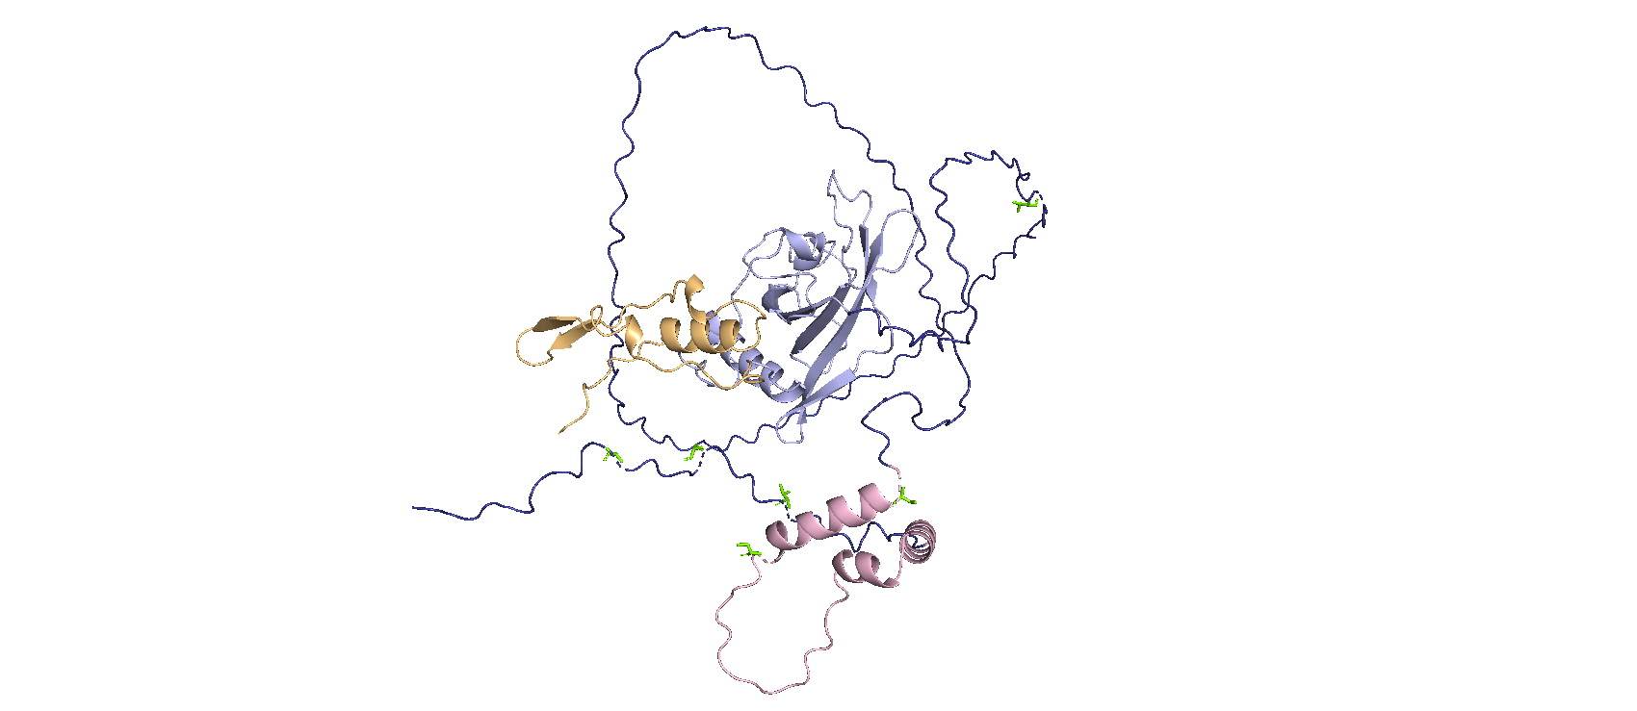
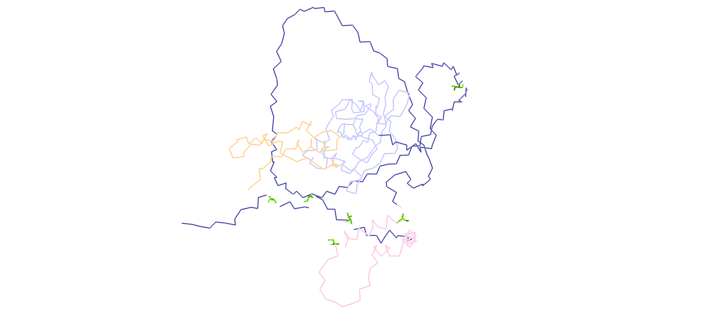
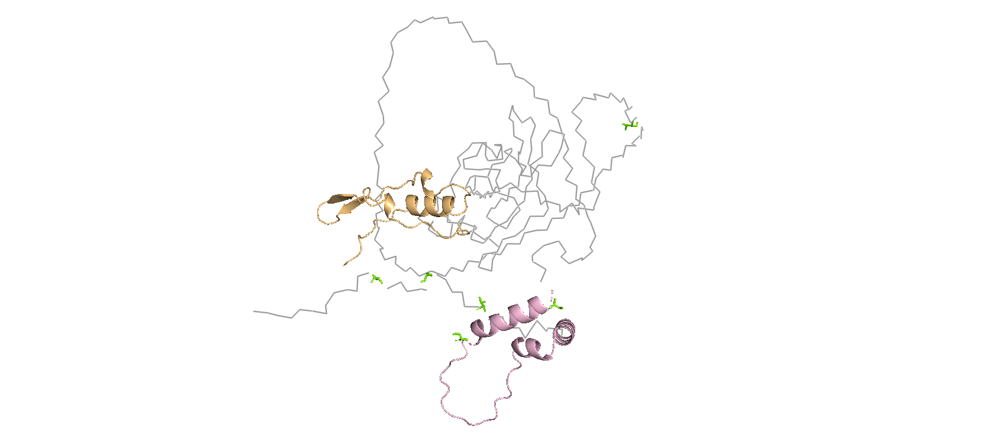
IV. AtSOG1 helical domain (HD) variations
[G.]
M1
K63
N355
K411
NHD
CHD
NTD
NAC
CTD
M1
L58
Q212
D449
M1
M1
M1
D449
D449
D449

Slide 31
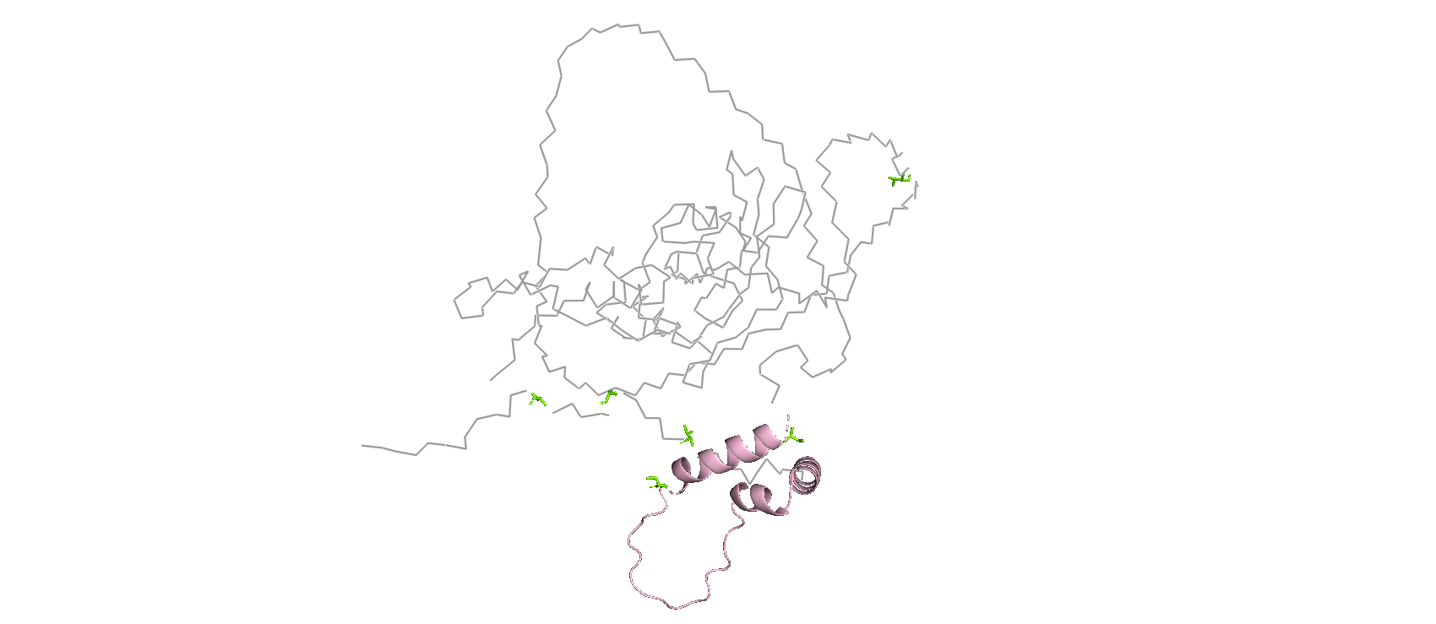
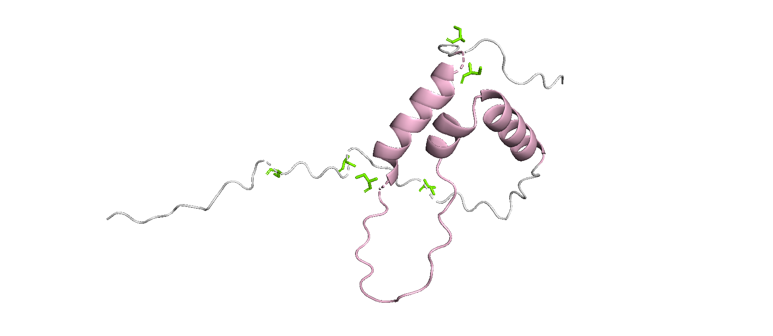
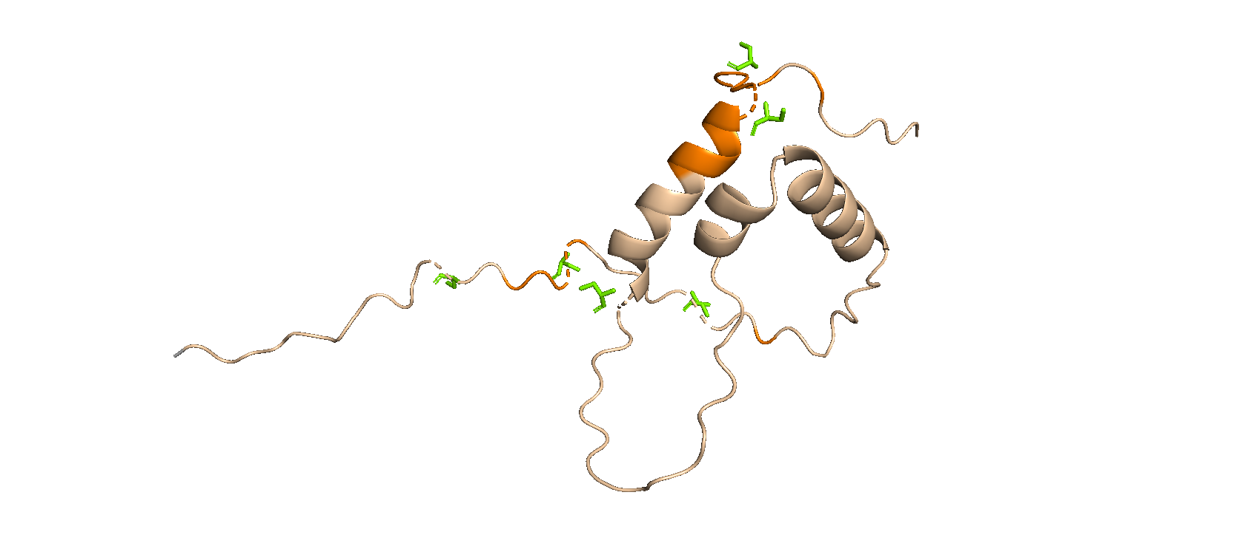
[G.]
+ TAD prediction
NTD
NAC
CTD
MAGRSWLIDS NRIATKIMSA SASSDPRQVV WKSNPSRHCP KCQHVIDNSD VVDDWPG
res 1-57 [57 aa]; pI 8,91
NTD
NAC
CTD
LPRGVKFDPS DPEIIWHLLA KSGLSGLSSH PFIDEFIPTV NQDDGICYTH PKNLPGVKSD GTVSHFFHKA IKAYSTGTRK RRKIHDDDFG DVRWHKTGRT KPVVLDGVQR GCKKIMVLYG GKAVKTNWVM HQYHLGIEED EKEGDYVVSK IFYQ
res 58-211 [154 aa]; pI 9,28
NTD
NAC
CTD
QPQQLVVKRG DKAEQEVSED IFAAVTPTAD PVTPKLATPE PRNAVRICSD SHIASDYVTP SDYVSAHEVS LAETSEVMCM
EDEVQSIQPN HERPSSGPEL EHGLENGAKE MLDDKEEQEK DRDNENQGEE DPTWFDSGSQ FILNSQQLVE ALSLCDDLLG SQDREENTNS GSLKDKQPCI ADYAHLGPED FKRDLEECQK IVLDPSNIEL DTPPEFRLSQ LEFGSQDSFL AWGTGKTD
res 212-449 [238 aa]; pI 4,47
Colors in figures match those in the AtSOG1 amino acid sequence.
Pink underlined = C-terminal helical domain (CHD)
Yellow = Predicted TAD region by either PADDLE or AdPred
Orange = Predicted TAD region by both PADDLE and AdPred
Green = Confirmed phosphosites

Slide 32
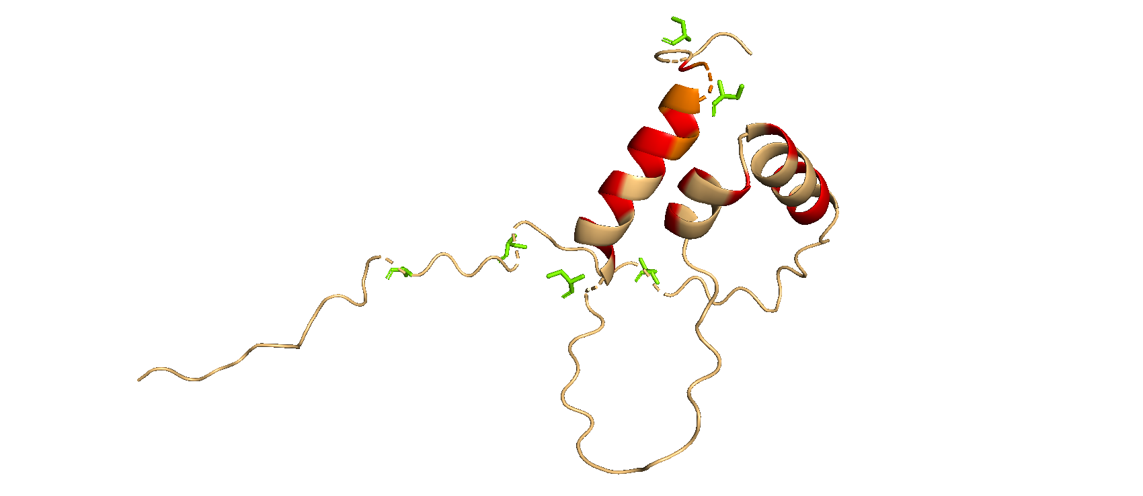
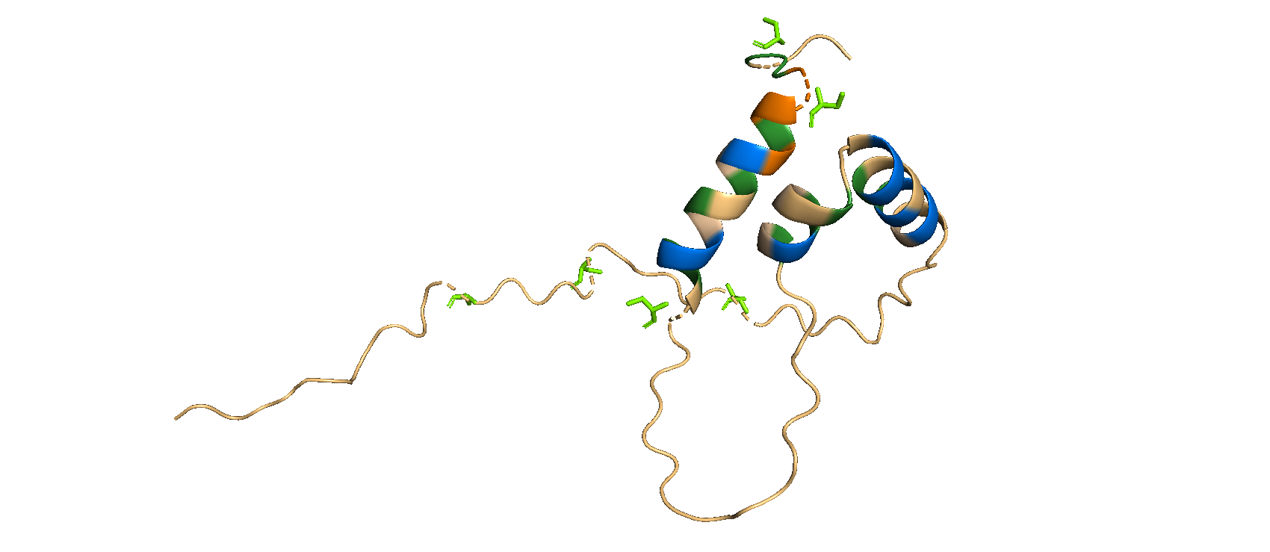
Disruption CHD helices 1, 2 and 3
P and G substitutions
FULL confirmed phospho-X background
Tile 35 (341-380): helix 1
Tile 35: EDPTWFDSGSQFILNSQQLVEALSLCDDLLGSQDREENTN
↓
Tile 35: EDPTWFDSGXQFIPNXQQGVPGPSGPDDGPGXQDREENTN
EDPTWFDSGSQFPLNSQQLPEALSLPDDLLGSQDREENTN
Tile 39 (381-420): helix 2 and 3
Tile 39: SGSLKDKQPCIADYAHLGPEDFKRDLEECQKIVLDPSNIE
↓
Tile 39: SGSLKDKQPCIPDYGHPGPPDFKRDGPGPQKIVLDPSNIE
SGSLKDKQPCIAPYAPLGPEDFPRDLEPCQKIVLDPSNIE
[G1a.]
1
2
3
1
2
3
Colors in figures match those in the AtSOG1 amino acid sequence.
Bold black = AA forming the C-terminal helices
Red = Positions where helix stabilizing AA are substituted by helix disrupting AA.
Green = (Bulky) hydrophobic residue: F, W, Y and L
Blue = Negative charged residue: D and E
Green = Confirmed phosphosites

Slide 33
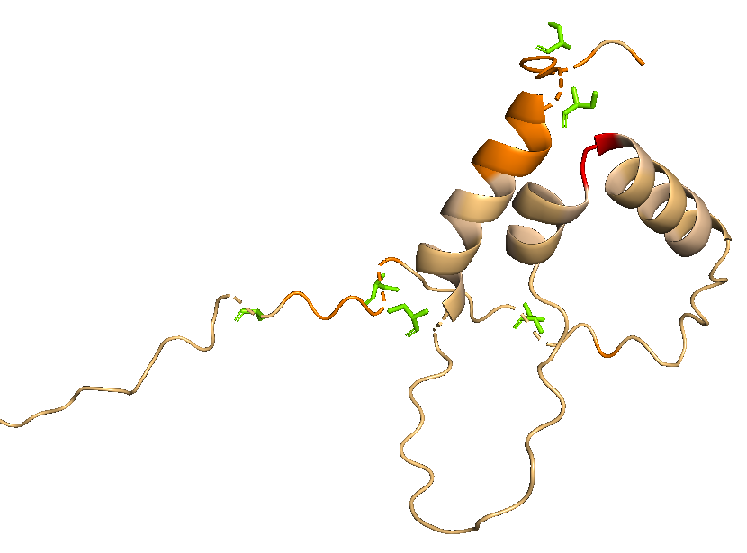
Disruption GP linker between helix 2 and 3
Tile 39 (381-420): GP → AA
SGSLKDKQPCIADYAHLGPEDFKRDLEECQKIVLDPSNIE
↓
SGSLKDKQPCIADYAHLAAEDFKRDLEECQKIVLDPSNIE
[G1b.]
Bold black= AA forming the C-terminal helices
Red = Position where linker is substituted by Ala
Yellow = Predicted TAD region by either PADDLE or AdPred
Orange = Predicted TAD region by both PADDLE and AdPred
Green = Confirmed phosphosites

Slide 34
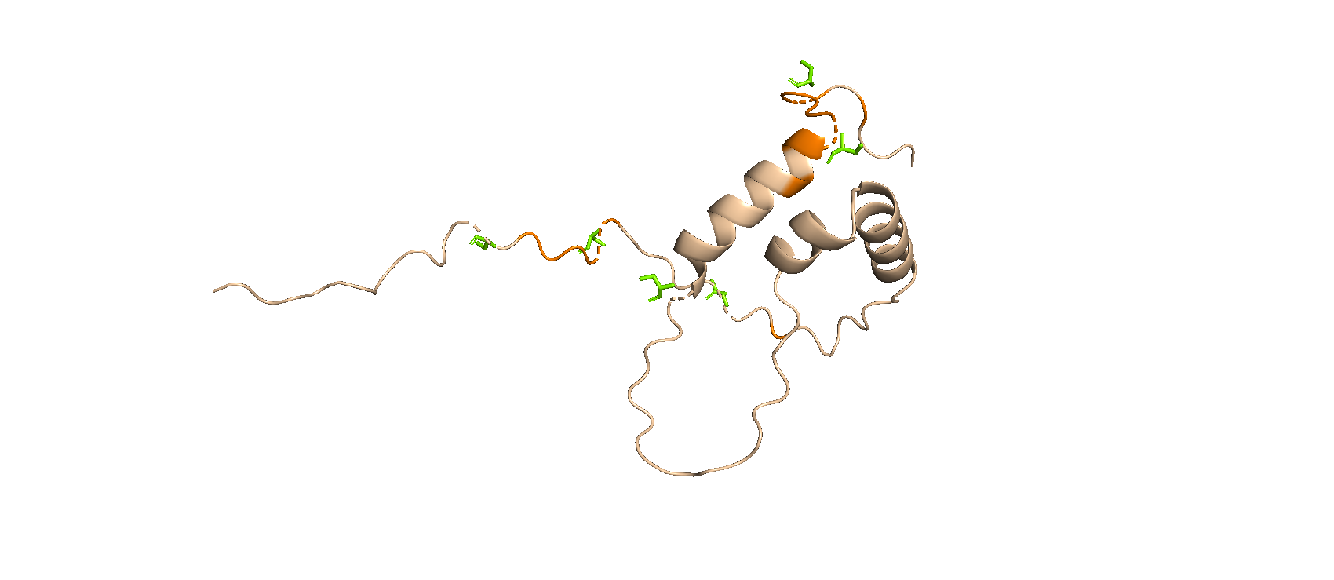
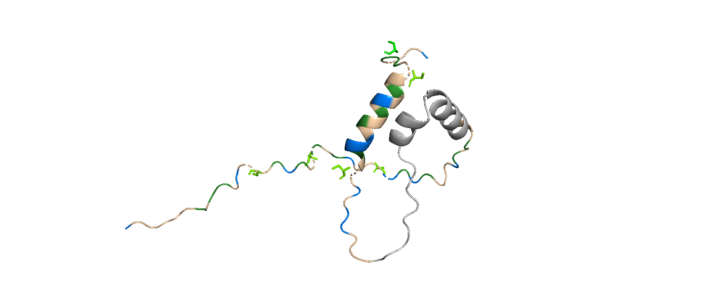
CHD variations in tiles encompassing the putative TAD
0% or 100% charge neutralization (D/E → N/Q) or reversal (D/E → K)
FULL confirmed phospho-X background
Partial (boxes) or full hydrofobicity neutralization
[G2.]
Tile 34 (331-370): KDRDNENQGE EDPTWFDSGS QFILNSQQLV EALSLCDDLL KDRDNENQGE EDPTWFDSGS QFILNSQQLV EALSLCDDLL
KDRDNENQGE EDPTWFDSGX QFILNXQQLV EALSLCDDLL
Tile 35 (341-380): EDPTWFDSGS QFILNSQQLV EALSLCDDLL GSQDREENTN
EDPTWFDSGS QFILNSQQLV EALSLCDDLL GSQDREENTN
EDPTWFDSGX QFILNXQQLV EALSLCDDLL GXQDREENTN
Tile 42 (410-449): QKIVLDPSNI ELDTPPEFRL SQLEFGSQDS FLAWGTGKTD QKIVLDPSNI ELDTPPEFRL SQLEFGSQDS FLAWGTGKTD
QKIVLDPSNI ELDXPPEFRL XQLEFGXQDS FLAWGTGKTD
Region 1
Region 2
Region 1
tiles 34-35
Region 2
tile 42
Notes:
Colors in figures match those in the AtSOG1 amino acid sequence.
Yellow = Predicted TAD region by either PADDLE or AdPred
Orange = Predicted TAD region by both PADDLE and AdPred
Green = (Bulky) hydrophobic residue: F, W, Y, L, M, I and V
Blue = Negative charged residue: D and E
Green = Confirmed phosphosites

Slide 35
[G3.]
CHD shuffle variants of tiles encompassing the putative TAD
Full confirmed phospho-X background
Charge and hydrophobicity unaltered
Tile 34 (331-370): KDRDNENQGE EDPTWFDSGS QFILNSQQLV EALSLCDDLL
Tile 35 (341-380): EDPTWFDSGS QFILNSQQLV EALSLCDDLL GSQDREENTN
Tile 42 (410-449): QKIVLDPSNI ELDTPPEFRL SQLEFGSQDS FLAWGTGKTD
Region 1
Region 2
Wild type sequence:
1 2 3 4 5 6 7 8 9 10 11 12 13 14 15 16 17 18 19 20
Full shuffle:
17 9 5 19 1 11 7 2 15 4 20 12 3 8 14 18 6 10 13 16
Shuffle putative TAD:
1 2 3 4 5 6 13 9 11 14 8 12 7 10 15 16 17 18 19 20
Shuffle the surroundings of the putative TAD:
4 6 1 3 2 5 7 8 9 10 11 12 13 14 17 19 16 20 18 15

Slide 36
Overview version 11: research questions
Basic tiles
Where is the AtSOG1 TAD located in its AA sequence?
Is this TAD conserved within the Arabidopsis NAC subfamily IX?
Is this TAD conserved amongst AtSOG1 orthologs?
II. AtSOG1 CTD phosphosite variations
Does the increase in negative net charge due to phosphorylation alter the identification of the AtSOG1 TAD in its AA sequence?
Does the increase in negative net charge due to phosphorylation alter the strength of the identified AtSOG1 TAD?
If so…
Do the experimentally confirmed AtSOG1 phosphosites suffice to induce this change or are additional phosphosites required (putative or not)?
Could the difference in TAD activity amongst variably phosphorylated tiles be linked to the SOG1 in planta phosphorylation priming behaviour?
III. AtSOG1 variations in charge and hydrophobicity in the putative TAD regions
Does the identified AtSOG1 TAD coincide with the results of the AdPred and/or PADDLE predictor?
Are negative charges originating from negatively charged residues and not those from phosphosites crucial to the identification and strength of the AtSOG1 TAD?
Is the presence of (bulky) hydrophobic residues crucial to the identification and strength of the AtSOG1 TAD?
Does the AtSOG1 TAD comply with the Acidic Exposure Model that was first formulated by Max Staller in his 2018 Cell Systems publication?
IV. AtSOG1 helical domain (HD) variations
Does the AtSOG1 TAD coincide with none, one or both of the helical domains (HD) predicted by AlphaFold?
If so…
Does disrupting helices in C-terminal region of AtSOG1 influence the TAD identification and/or activity ?
Do alterations in phosphosite background, charge and hydrophobicity have an individual and combined effect on the TAD activity?
Is the TAD activity dependent on specific sequence motifs or overall charge and hydrophobicity features?
V. Control tiles
Does the experimental set-up work for plant protein sequences as it does for yeast and mammalian protein sequences?

Slide 37
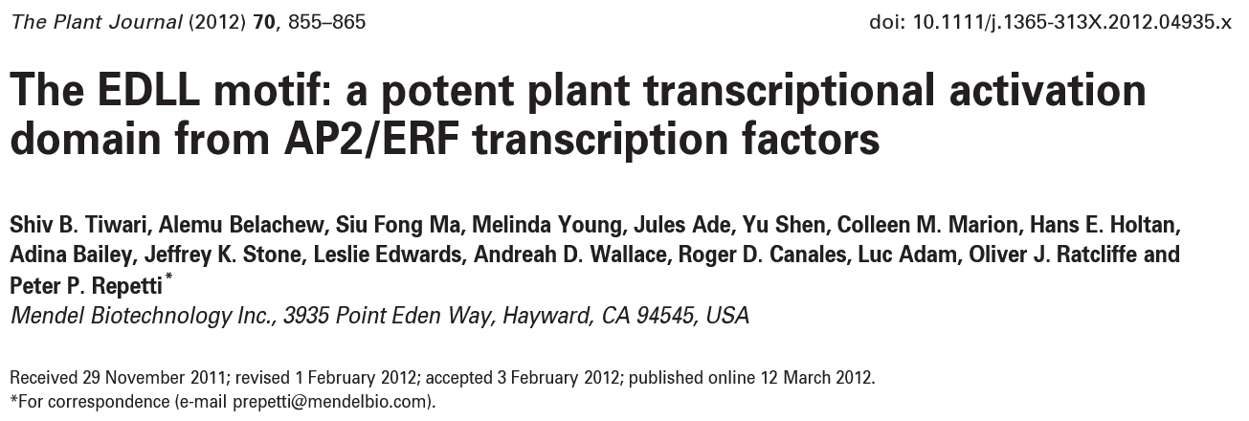
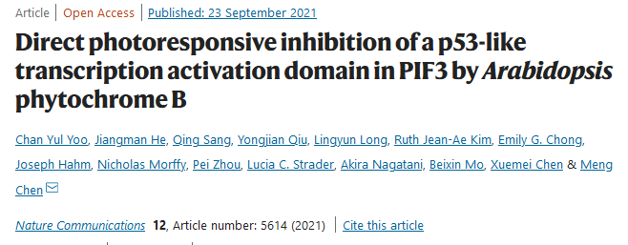
V. Control tiles
[H.]
(+) 3 yeast Gcn4 low activity tiles selected from the list provided by Max Staller.
>Gnc4Lib_Charge_LOW STDSTPMFEYENLENNSKEWTSLFDNDIPVTTDDVSLADK
>Gnc4Lib_Disorder_LOW STDSTPMFEYEGLEDNSKEWTSLFDNDIPVTTDDVSPADK
>Gnc4Lib_HoldChargeDisorder_LOW STDSTPMFDYDNLEDNSKDWTSLFDNDIPVTTDDVSLADK
(+) 2 tiles based on Arabidopsis TADs described in literature:
AtERF98 (Uniprot Q9LTC5) TAD: residues 115-139 → Tile encompasses residues 99-139
(Yoo et al. 2021; doi: 10.1111/j.1365-313X.2012.04935.x )
>AtERF98_res99till139_Tiwari2012 SSSGSTSTNVSRQNQREVFEFEYLDDKVLEELLDSEERKR
AtPIF3 (Uniprot: O80536) TAD: residues 91-114 → Tile encompasses residues 85-124
(Tiwari et al. 2012; doi: 10.1038/s41467-021-25909-5)
>AtPIF3_res91till114_Yoo2021 TGLSQDDDFVPWLNHHPSLDGYCSDFLRDVSSPVTVNEQE
(+) 10 tiles from a library of plant proteins

